Slide 1





Climate Risk Stress Testing |
A Case Study of Malaysia’s Banking System
Dr Lim Kok Tiong
PhD, University Malaya
Date: Time: Platform:
URL:
Publishing
25 July 2023 (Tuesday) 2:30pm to 3:30pm Microsoft Teams https://bit.ly/30597yB Under consideration
An incumbent advising financial services industry across APAC. Prior undertakings at Moody’s Analytics and Deloitte in Director capacity. Research interest: asset pricing,
credit rating, sustainable financing and climate risks

Slide 2

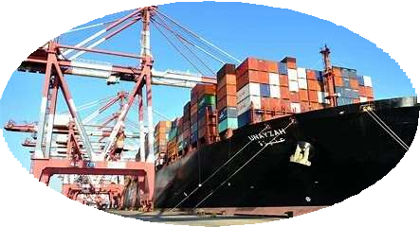


Abstract
Research Motivations:
Net Zero Emissions (NZE) mandate – Network for Greening Financial System (NGFS)
2024 Climate Risk Stress Testing (CRST) Consultative Paper (Hot House World) – Bank Negara Malaysia
Climate related financial risks – Basel Committee on Bank Supervision (BCBS)
Aim:
To assess the financial impacts posed by the physical and transition climate risks on Malaysia’s banking system
Findings:
Flooding (Physical) – Loans portfolio to contract by 0.4 to 2% & ECL to expand by 6.3 to 22.5%
Export Shock (Transition) – Loans portfolio to contract by 2 to 3% & ECL to expand by 25.4 to 135%
Carbon Premium (Transition) – Loans portfolio to contract by approx. 6.4% & ECL to expand by approx. 19.2%

Slide 3
Abstract (Continued)
Policy Recommendation:
Carbon premium on Loans and Advances as policy tool for the BNM to champion the NZE mandate

Slide 4

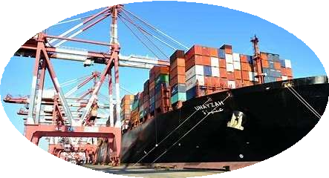


Agenda
Background
Literature Review
Data & Methodology
Results & Discussion
Conclusion

Slide 5
Background
Net Zero Emissions (NZE) mandate
Growing intensity for banks to carry out concrete actions in meeting the NZE mandate
Malaysia is a member Network for Greening Financial System (NGFS)
Clear initiative from BNM on the 2024 Climate Risk Stress Testing (CRST) Consultative Paper
Potential Physical and Transition Climate Risks
2021 flooding event in Malaysia estimated to be around MYR6 billion in damages – 15x the average damage in 20 years
Pressure is growing for Malaysia to impose the carbon taxation on CO₂ emissions – Singapore & Japan charging USD5 per mtCO₂e
Potential export ban on product associated with high CO₂ emissions – Europe ban palm oil import on the ground of deforestation.

Slide 6
Background (Continued)
Research Objectives:
This paper aims to extrapolate the financial impacts posed by physical and transition climate risks on Malaysia’ banking system
The research approach and outcomes would contribute as one of the earliest references in the context of the climate risk stress testing(CRST), the emerging subject.

Slide 7
Literature Review
A total of 52 pieces of literature cited in this paper
Majority are current literature and could be grouped into three categories:
Climate Change:
e.g., Nordhaus (2017)
Budolfson et al. (2017)
Dietz et al. (2021)
Parry, Black, and Zhunussova (2022)
Climate Risk Impact on Banks:
e.g., Cantelmo, Melinna, and
Papageorgiou (2019)
Faiella and Lavecchia (2020) Belloni, Kuik, and Mingarelli (2022)
Takahashi and Shino (2023)
Climate Risk Scenario & Framework
e.g.,
NGFS-FSB(2022)
BCBS (2021b) BNM (2022)
ECB (2022)
Research Framework, Climate Risk Scenarios, Data, and Methodology

Slide 8
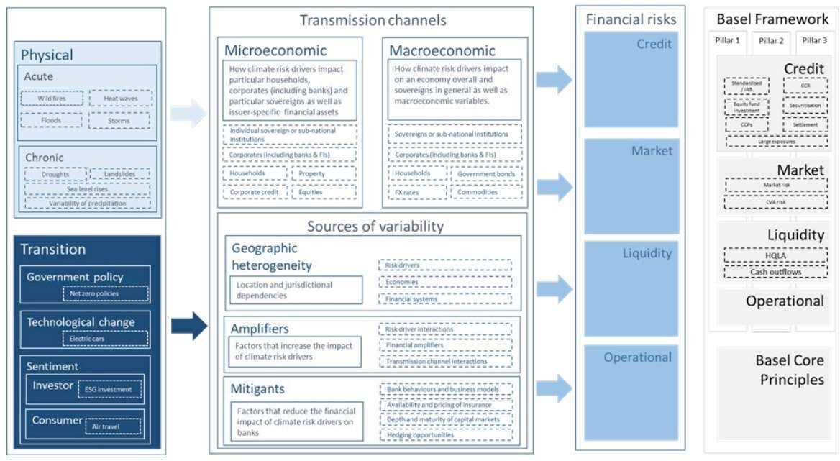
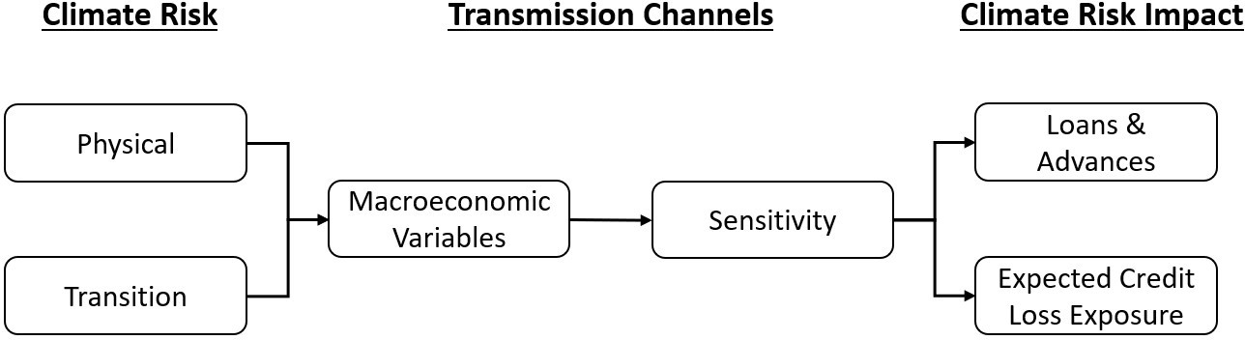
Research Framework
This paper aims to extrapolate the financial impacts posed by physical and transition climate risks on Malaysia’ banking system using the BCBS framework as the guide.
Figure 5: Empirical Framework
Note: This diagram is reproduced from Figure 1 in page 4 (BCBS 2021b)

Slide 9

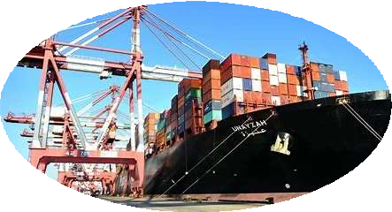

Hypotheses: Climate Risk Scenarios
Three climate risk scenarios are “Flooding” (physical climate risk), “Export Shock” (transition climate risk) and “Carbon Premium” (transition climate risk):
Scenario 1: Flooding
Reference: 2021 Flooding Event
Cantelmo, Melinna, and Papageorgiou (2019)
Scenario 2: Export Shock
Reference:
EU Deforestation Ban US Forced Labour Ban
Department of Statistics Malaysia
Scenario 3: Carbon Premium
Reference: Singapore USD5/mtCO₂e
Japan USD5/mtCO₂e
Parry, Black, and Zhunussova (2022)
Transmitted through:
GDP at -0.5%
Unemployment Rate at +0.5%
Transmitted through:
GDP at -2%
Unemployment Rate at +3%
Transmitted through:
Overnight Policy Rate at 0.4%
Impact on Banks’ Loans and Advances and Expected Credit Loss Exposure
*All three scenarios are deliberated through cross-referencing pertinent literature, historical records from Department of Statistics Malaysia (DSOM) and Bank Negara Malaysia (BNM), and climate policies implemented by countries in the region.

Slide 10


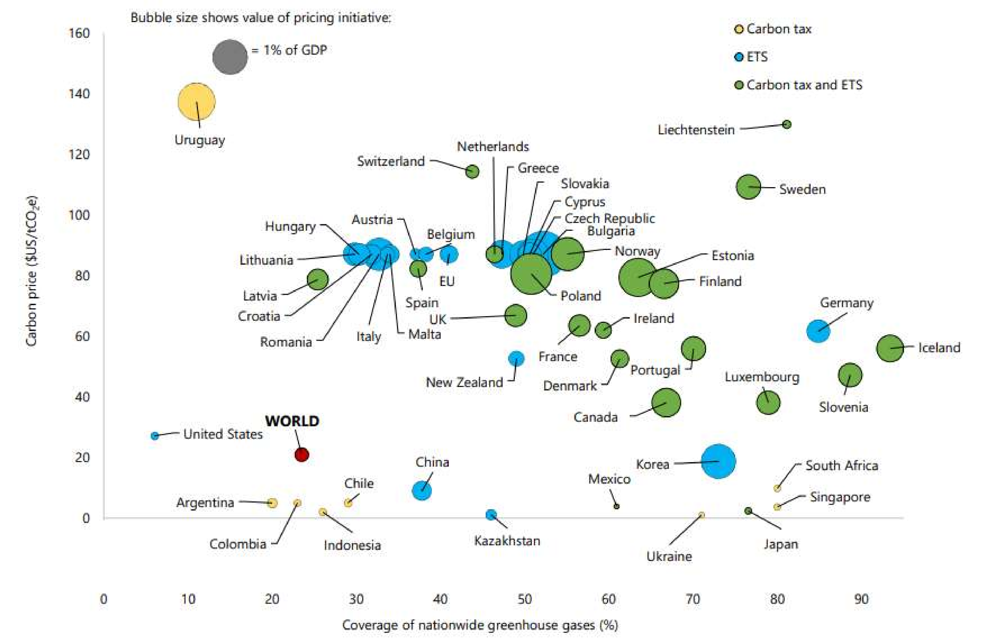
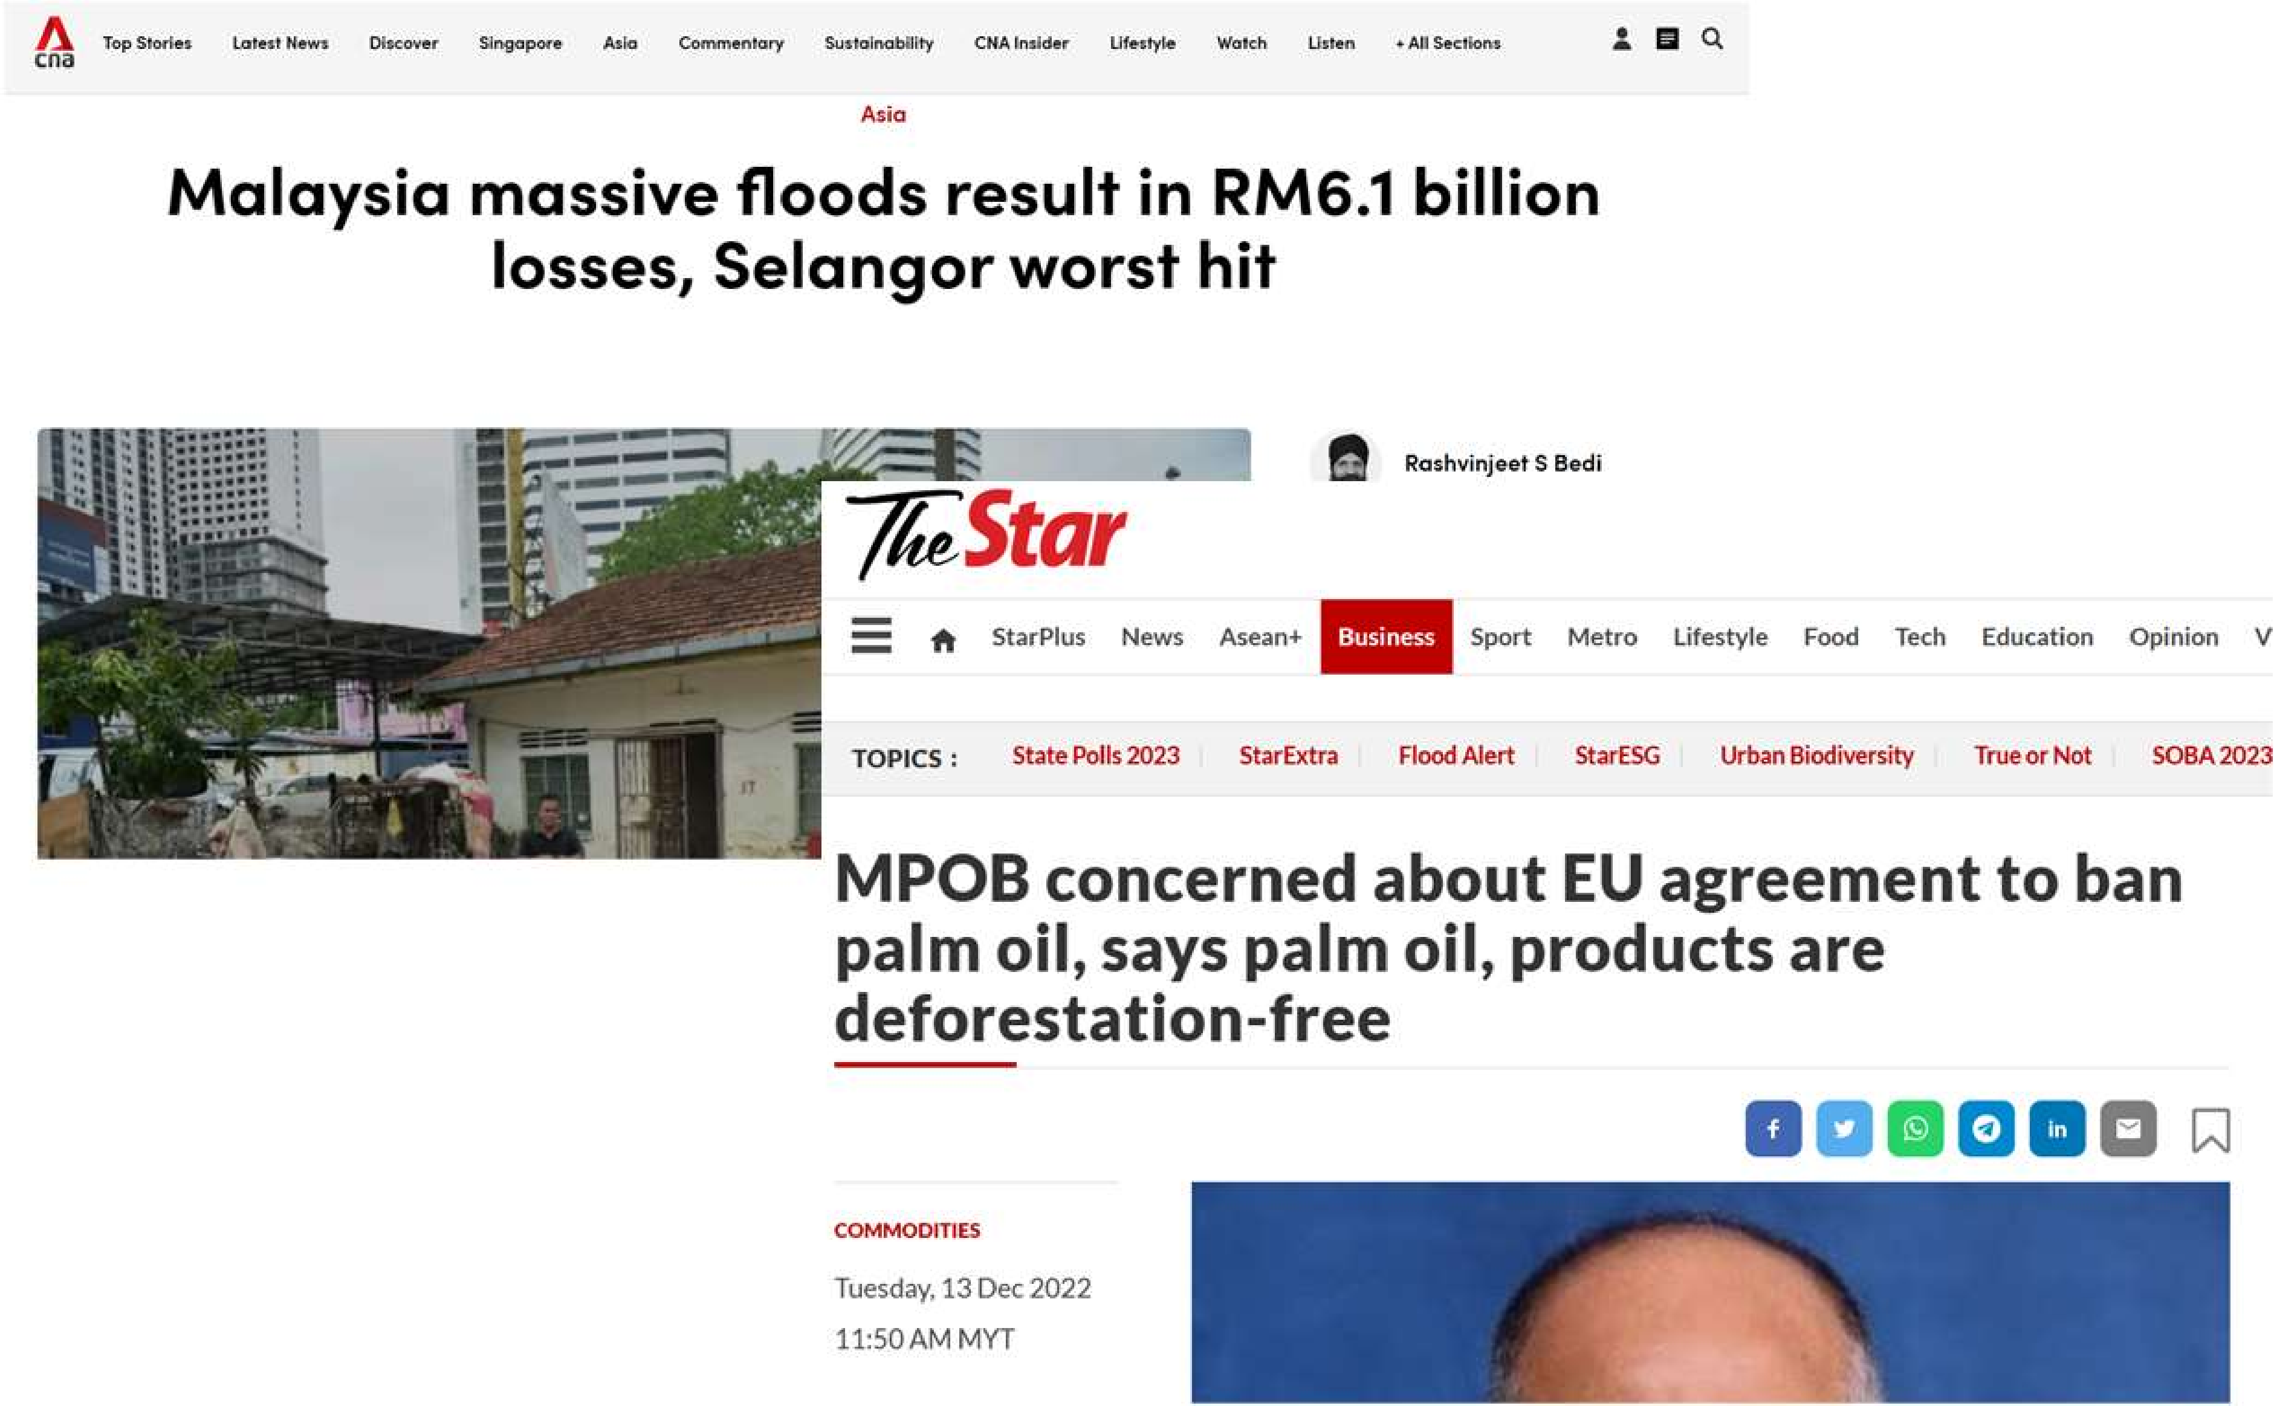

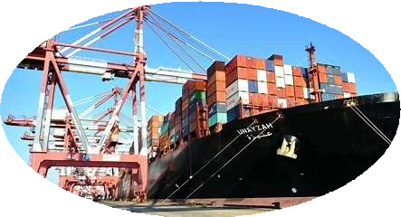
Hypotheses: Climate Risk Scenarios (Continued)
Note: Reproduced from (Parry, Black, and Zhunussova 2022), Figure 2 in page 2

Slide 11
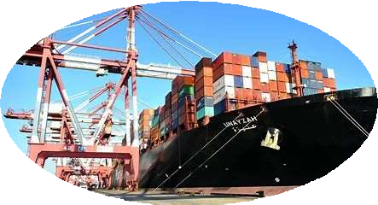
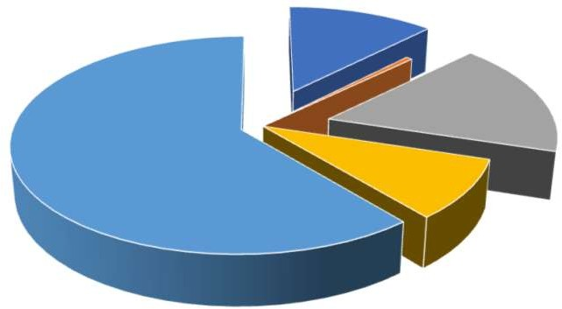
Hypotheses: Climate Risk Scenarios (Continued)
MYR 'Mil
Import 76,637
232,681
33,308
474,024
15,799
78,294
24,604
26,459
25,539
987,344
Malaysia Employment by Sector in 2021
Year 2021 Europeª Asean Middle East
North & South Asia Africa
North America^{b}
Central South America Oceania
Others Total
Export 103,721
343,503
25,696
489,322
30,405
148,603
25,254
41,654
32,865
1,241,022
Trade Balance 27,084
110,822
- 7,612
15,298
14,605
70,309
650
15,196
7,326
253,678
Agriculture 12%
Mining and quarrying 1%
Manufacturing 17%
Note: Statistics are sourced Department of Statistics Malaysia (dosm.gov.my). a = The EU Deforestation- Free Products Regulation has direct effect on palm oil export due to deforestation claims. b = The US Customs and Border Protection Agency has banned import of palm oil and gloves due to forced labour claims
Services 61%
Construction 9%
Note: The pie chart is illustrated using data sourced from Department of Statistics Malaysia (dosm.gov.my)

Slide 12
Data
Dependent Variables: Loans & Advances (LG) and Expected Credit Loss (ECL) are gathered from 19 banks’ annual reports spanning from 2012 to 2021.
Independent Variables: ROE is sourced from banks’ annual reports, and the GDP, HPI, INF, OPR and UR are sourced from the DOSM and the BNM
Preliminary Data Analyses are performed:
  Unit Root Test: - results show that the ECL contains unit root but with first difference, it is stationary
  Panel Cointegration Test: - results show that independent variables have long-term relation with the dependent variables
  Correlation Analysis: - result shows that independent variables are highly correlated

Slide 13
Data (Continued)
List of Banks
Affin Bank^{L} | Bank of China | HSBC | Public Bank^{L}
Al Rajhi | Bank Rakyat^{L} | JP Morgan | RHB^{L}
Ambank^{L} | CIMB^{L} | Maybank^{L} | SCB
Bangkok Bank Bank of America | Deutsche Bank Hong Leong Bank^{L} | Nova Scotia OCBC | UOB
Note: Countries tagged with superscript L denotes local banks else foreign banks operating in Malaysia

Slide 14
Data (Continued)
Descriptive Statistics
Dependent
Independent
 | LG | ECL | ROE | GDP | HPI | INF | OPR | UR
Mean | 0.07 | 0.16 | 8.61 | 3.83 | 6.29 | 1.78 | 2.79 | 3.46
Median | 0.04 | 0.02 | 8.76 | 4.75 | 6.80 | 2.10 | 3.00 | 3.30
Maximum | 1.83 | 9.18 | 24.10 | 6.00 | 13.40 | 3.70 | 3.25 | 4.60
Minimum | -0.50 | -0.85 | -9.56 | -5.50 | 1.20 | -1.20 | 1.75 | 2.90
Std. Dev. | 0.25 | 0.76 | 5.20 | 3.23 | 4.06 | 1.32 | 0.53 | 0.57
Observation | 190 | 190 | 190 | 190 | 190 | 190 | 190 | 190
Note: LG = Loan Growth Rate, ECL = Expected Credit Loss Growth Rate, GDP = GDP Growth Rate, HPI = Housing Price Index, INF = Inflation, OPR = Overnight Policy Rate, ROE = Return on Equity, and UR = Unemployment Rate.

Slide 15
Methodology
Sensitivity Analyses: Forward Orthogonal Transformation of Generalized Method of Moments (FOD-GMM)
  GMM is a proven econometric method on financial related research (e.g., Athanasoglou, Brissimis, and Delis 2008, Caby, Ziane, and Lamarque 2022, Dietrich and GabrielleWanzenried 2014, Teixeira et al. 2020
  GMM addresses the endogeneity issue - lagged dependent variable as one of the explanatory variables
  FOD method is chosen over First Difference (FD) because it proven to have higher efficiency (e.g., Hayakawa (2009), Phillips (2019), Hsiao and Zhou (2017))

Slide 16
Methodology (Continued)
Model Specification:
𝑦_{it} = 𝛼𝑦_{it–1} + 𝛽𝑐_{it} + 𝛾𝑚_{it} + 𝛿𝑛_{i} + 𝑣_{it}
where 𝑦_{it} is the dependent variable (e.g., LG or ECL) of bank 𝑖 at time 𝑡, 𝑦_{it–1} denotes the endogenous variable, 𝑐_{it} denotes the ROE, ECL and LG variables, 𝑚_{it} denotes the vector of macroeconomic variables: GDP Growth Rate (GDP), Housing Price Index (HPI), Inflation (INF), Overnight Policy Rate (OPR) and Unemployment Rate (UR), 𝑛_{i}is an unobserved time-invariant effect, and 𝑣_{it} denotes the error terms. The parameters are denoted by 𝛼, 𝛽, 𝛾, and 𝛿. In particular, the 𝛾 is the parameter of interest to assess the impacts of the three climate risk scenarios

Slide 17
Methodology (Continued)
Assessment & Robustness Validation
  A series of 40 regression models is performed with the combination of control variables (𝑐_{it})
  Sargan test is used to validate each model (e.g., Arellano and Bond (1991), Arellano and Bover (1995), Roodman (2006))
  Signs and significance levels of estimated parameters from validated models are assessed for robustness
Climate Risk Impact Extrapolation –
  The impact of each deliberated climate risk scenario on banks’ loans & advances (LG) and expected credit loss exposure (ECL) are transmitted through robust parameters of the designated transmitters

Slide 18
Methodology (Continued)
Scenario | Climate Risk Category and Risk Specific | Risk Transmitters | Expected Correlation | Outputs
1 | Physical Risk - Flood | GDP Growth Rate (GDP) | Positive | Loan Growth Rate (LG)
 |  |  | Negative | ECL Growth Rate (ECL)
 |  | Unemployment Rate (UR) | Negative | Loan Growth Rate (LG)
 |  |  | Positive | ECL Growth Rate (ECL)
2 | Transition Risk - Export Shocks | GDP Growth Rate (GDP) | Positive | Loan Growth Rate (LG)
 |  |  | Negative | ECL Growth Rate (ECL)
 |  | Unemployment Rate (UR) | Negative | Loan Growth Rate (LG)
 |  |  | Positive | ECL Growth Rate (ECL)
3 | Transition Risk - Carbon Premium | Overnight Policy Rate (OPR) | Positive | Loan Growth Rate (LG)
 |  |  | Positive | ECL Growth Rate (ECL)
Note: see Section 3 for more details.

Slide 19
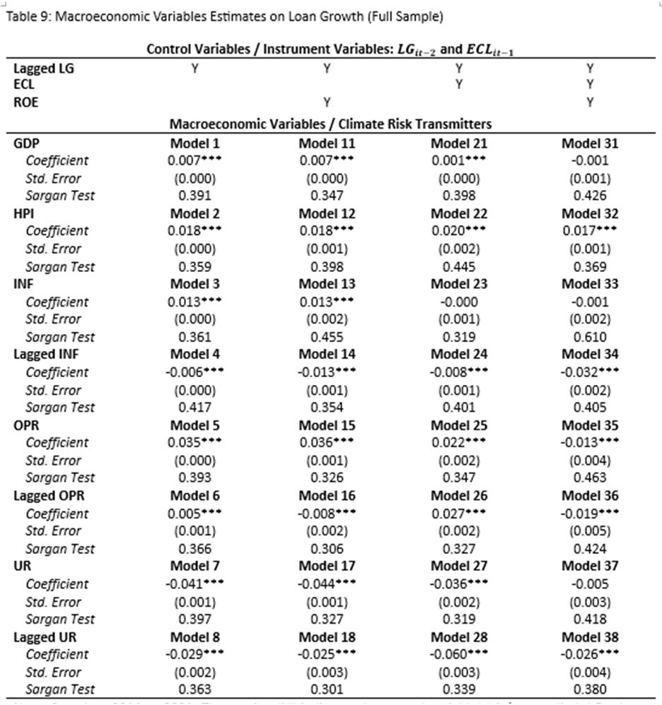
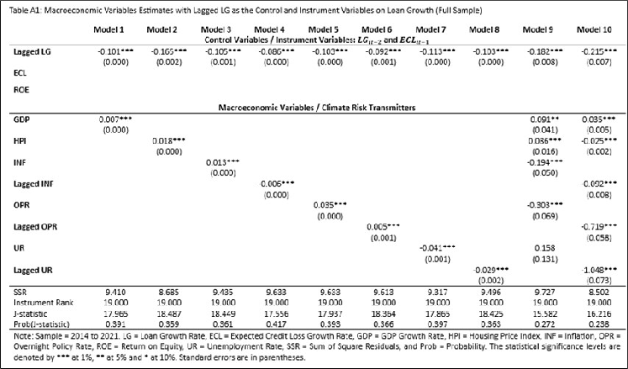
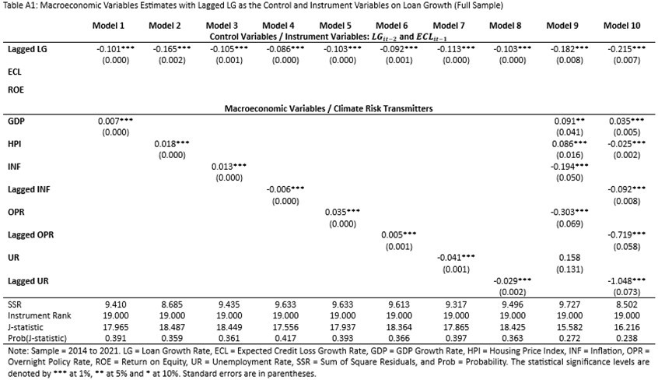
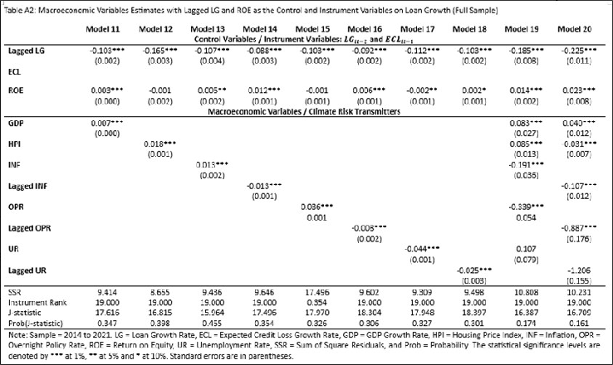
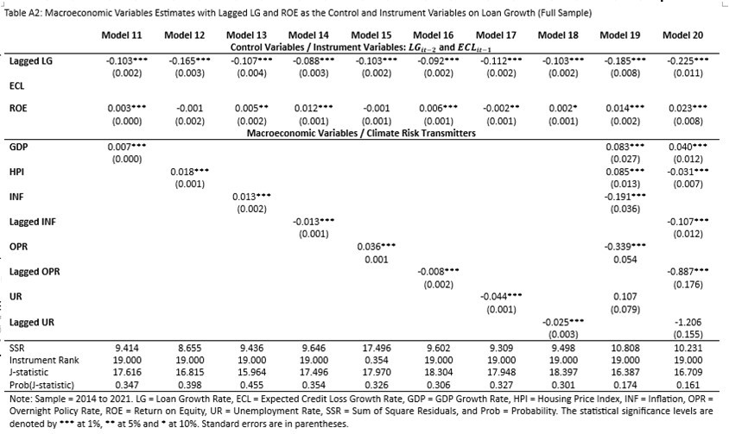
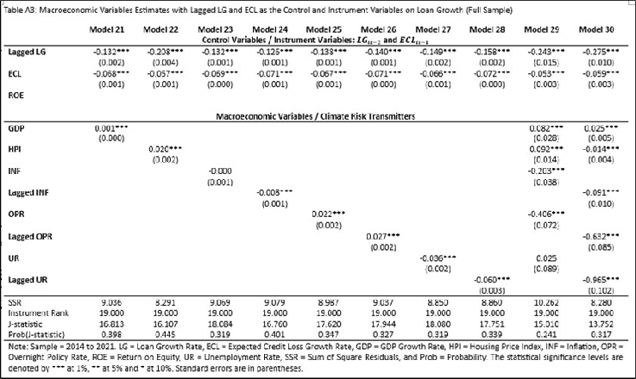
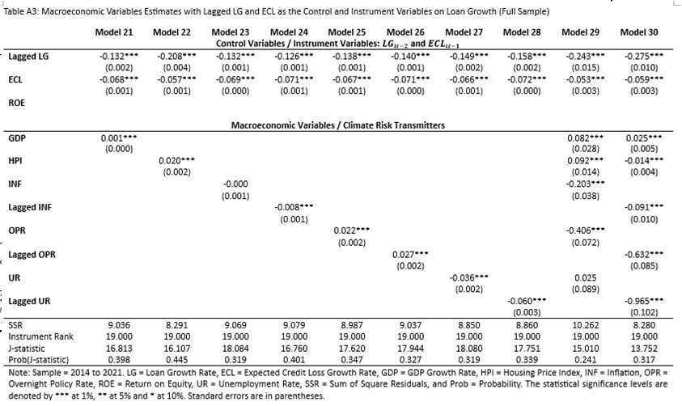
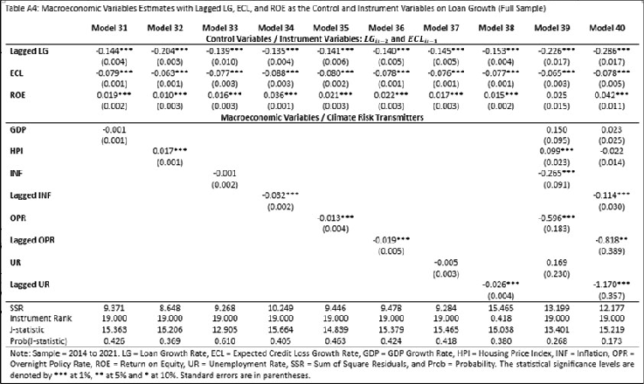
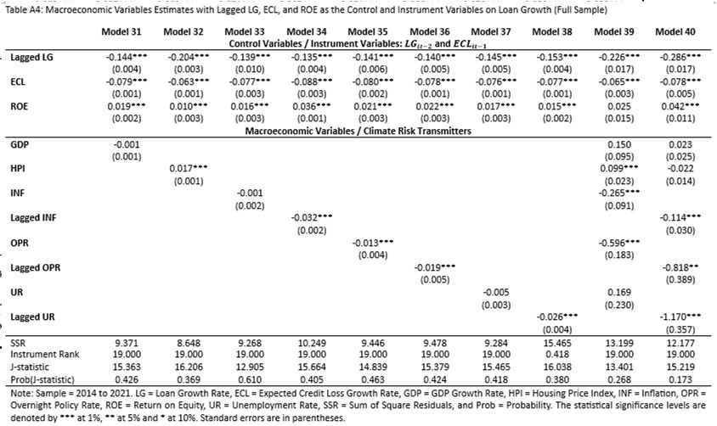
Empirical Results

Slide 20
Empirical Results (Continued)
Key Takeaways from the Macroeconomic Variables Sensitivity Analyses
Macroeconomy variables | Influence on LG | Influence on ECL
 | Full Sample | Full Sample
GDP* | Yes – Robust | Yes – Robust
HPI | Yes - Robust | Yes – Robust
INF | No – Not Robust | No – Not Robust
Lagged INF | No – Not Robust | No – Not Robust
OPR | Yes – Robust | No – Effect on ECL is lagged
Lagged OPR* | No – Not Robust | Yes – Robust
UR* | Yes – Robust | Yes – Robust
Lagged UR | Yes – Robust | No – Not Robust
Note: Macroeconomy variables tagged with * are selected climate risk transmitters

Slide 21

Empirical Results (Continued)
Extrapolation – financial impacts posed physical & transition climate risks on Malaysia’s banking system
Impact on Banks’ Loans and Advances
Impact on Banks’ Expected Credit Loss Exposure
Scenario 1: Flooding
Transmitters | GDP @ -0.5% | UR @ +0.5% | OPR @ N/A
Multiplier | +0.7% | -4.0% | -
Outcome | -0.35% | -2% | -
Note: The GDP multiplier is an average derived from Models 1 and 11 in Table 9, the UR multiplier is an average derived from Models 7,17 and 27 in Table 9, the OPR multiplier is a net average derived from the OPR and lagged OPR in Table 9.
Scenario 1: Flooding
Transmitters | GDP @ -0.5% | UR @ +0.5% | OPR @ N/A
Multiplier | -12.7% | +45.0% | -
Outcome | +6.35% | +22.5% | -
Note: The GDP multiplier is an average derived from Models 1, 11, 21 and 31 in Table 11, the UR multiplier is an average derived from Models 7,17, 27 and 37 in Table11, the OPR multiplier is an average derived from Models 6, 16, 26 and 36 in Table 11.

Slide 22
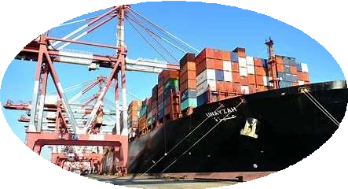
Empirical Results (Continued)
Extrapolation – financial impacts posed physical & transition climate risks on Malaysia’s banking system
Impact on Banks’ Loans and Advances
Impact on Banks’ Expected Credit Loss Exposure
Scenario 2: Export Shock
Transmitters | GDP @ -2% | UR @ +3% | OPR @ N/A
Multiplier | +0.7% | -4.0% | -
Outcome | -1.4% | -12% | -
Note: The GDP multiplier is an average derived from Models 1 and 11 in Table 9, the UR multiplier is an average derived from Models 7,17 and 27 in Table 9, the OPR multiplier is a net average derived from the OPR and lagged OPR in Table 9.
Scenario 2: Export Shock
Transmitters | GDP @ -2% | UR @ +3% | OPR @ N/A
Multiplier | -12.7% | +45.0% | -
Outcome | +25.4% | +135% | -
Note: The GDP multiplier is an average derived from Models 1, 11, 21 and 31 in Table 11, the UR multiplier is an average derived from Models 7,17, 27 and 37 in Table11, the OPR multiplier is an average derived from Models 6, 16, 26 and 36 in Table 11.

Slide 23

Empirical Results (Continued)
Extrapolation – financial impacts posed physical & transition climate risks on Malaysia’s banking system
Impact on Banks’ Loans and Advances
Impact on Banks’ Expected Credit Loss Exposure
Scenario 3: Carbon Premium
Transmitters | GDP @ N/A | UR @ N/A | OPR @ +0.4%
Multiplier | - | - | +16%
Outcome | - | - | 6.4%
Note: The GDP multiplier is an average derived from Models 1 and 11 in Table 9, the UR multiplier is an average derived from Models 7,17 and 27 in Table 9, the OPR multiplier is a net average derived from the OPR and lagged OPR in Table 9.
Scenario 3: Carbon Premium
Transmitters | GDP @ N/A | UR @ N/A | OPR @ +0.4%
Multiplier | - | - | +48%
Outcome | - | - | +19.2%
Note: The GDP multiplier is an average derived from Models 1, 11, 21 and 31 in Table 11, the UR multiplier is an average derived from Models 7,17, 27 and 37 in Table11, the OPR multiplier is an average derived from Models 6, 16, 26 and 36 in Table 11.

Slide 24




Conclusion
While Malaysia may be in the non-disaster-prone-country category, the impacts posed by physical and transition climate risks are significance.
Amongst the three examined climate risk scenarios:
Financial impact posed by “Export Shock” scenario is
10% impact on export to the US and Europe is simulated through GDP and UR
severe on Malaysia’s banking system
Recurrence of 2021 flooding is simulated through GDP and UR
USD5/mtCO₂e is simulated through carbon premium

Slide 25


Conclusion (Continued)
Policy recommendation:
USD5/mtCO₂e is simulated through carbon premium
Carbon Premium
Carbon premium on loans and advances to brown sectors. This is a critical climate risk tool for BNM and within its jurisdiction to charter the pathway for banks to meet the NZE mandate by 2050
Carbon Credit
ETF on Carbon Allowance through Voluntary Carbon Market (VCM) platform regulated by Securities Commission (SC)
Carbon Tax
Being mooted for implementation potentially a joint jurisdictions: Lembaga Hasil Dalam Negeri (LHDN) and Department of Environment (DOE)

Slide 26
Conclusion (Continued)
Carbon Premium Rationales:
  To sustain brown sectors with continue financing – to minimize impact on employment market and the 60% household segment
  As agent of change – brown sectors may sunset gradually due to higher borrowing cost
  Proceeds from carbon premiums would be a sizeable private fund (approx. MYR3- 4billion/year from non-household segment) to develop the green sector and a plus to ETF VCM platform.
  Through carbon premium, banks are able to contribute constructively in sustaining existing economy and developing the green sector,
  Through carbon premium, brown sectors also contributing in the green sector development
  Within the BNM jurisdiction, BNM can determine the concerted premium rate and target sector (e.g., export sensitive sectors) in achieving the NZE mandate while ensuring the core mandate on price stability being in tact.

Slide 27
Climate Risk Stress Testing |
A Case Study of Malaysia’s Banking System
Thank You

