Slide 1
The Financial System We Need:
What Should the Financial Sector Do in the Face of Climate and Environmental Change?
@UliVolz
@CSF_SOAS
Professor Ulrich Volz
Lecture at Universiti Malaya
23 August 2022

Slide 2
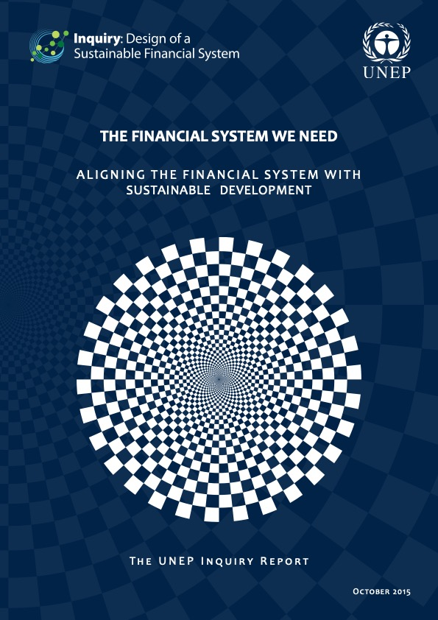

Slide 3
Outline
Climate and environmental change
What does finance have to do with this?
Climate-related financial and macroeconomic risks
Is ESG the answer?
Governing sustainable finance
Notes:
Here is the outline of this lecture.
After a brief Introduction, I will explain some key concepts and developments, before talking about Environmental, social and governance (ESG) standards & socially responsible investment (SRI) and banking.
We will then look at the discrepancies between ambition and reality in aligning finance, and then turn to the role of central banks and look at some emerging practice.

Slide 4
Climate and environmental change

Slide 5
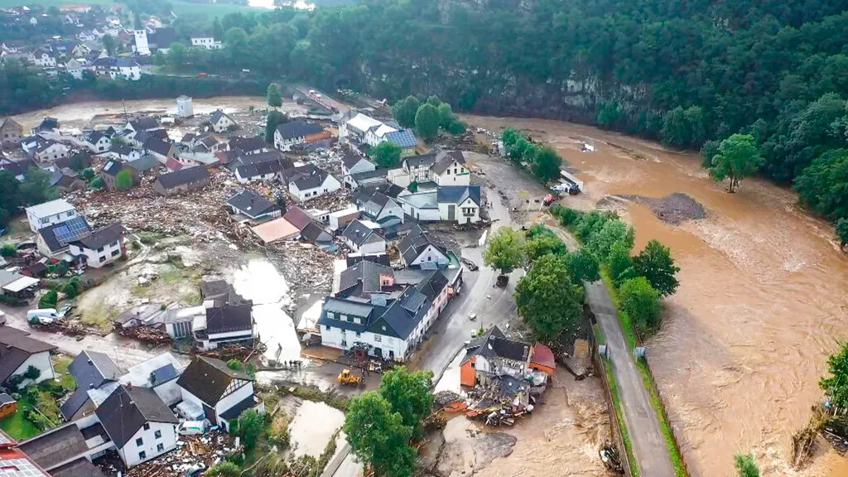

Slide 6
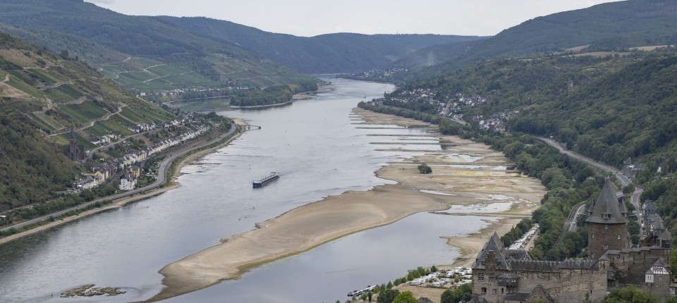

Slide 7
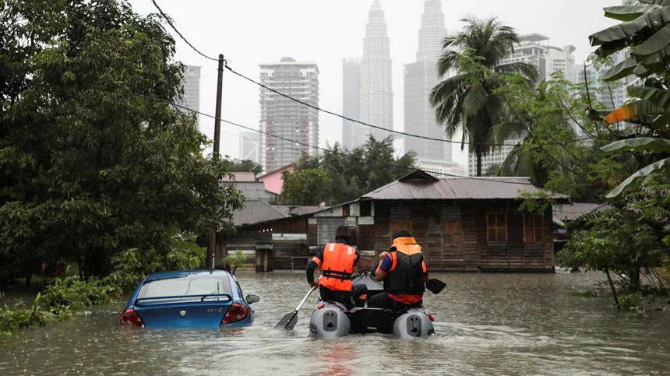

Slide 8
Climate impacts are already more widespread and severe than expected
Climate change is already causing widespread disruption in every region in the world with just 1.1°C of warming.
Withering droughts, extreme heat and record floods already threaten food security and livelihoods for millions of people.
Wildfires are scorching larger areas than ever before in many regions, leading to irreversible changes to the landscape.
Higher temperatures are also enabling the spread of vector-borne diseases.
Climate change is also harming species and whole ecosystems.
Notes:
Climate change is already causing widespread disruption in every region in the world with just 1.1°C of warming.
Withering droughts, extreme heat and record floods already threaten food security and livelihoods for millions of people.
Since 2008, devastating floods and storms have forced more than 20 million people from their homes each year.
Today, half the global population faces water insecurity at least one month per year.
Wildfires are scorching larger areas than ever before in many regions, leading to irreversible changes to the landscape.
Higher temperatures are also enabling the spread of vector-borne diseases, such as West Nile virus, Lyme disease and malaria, as well as water-borne diseases like cholera.
Climate change is also harming species and whole ecosystems.

Slide 9
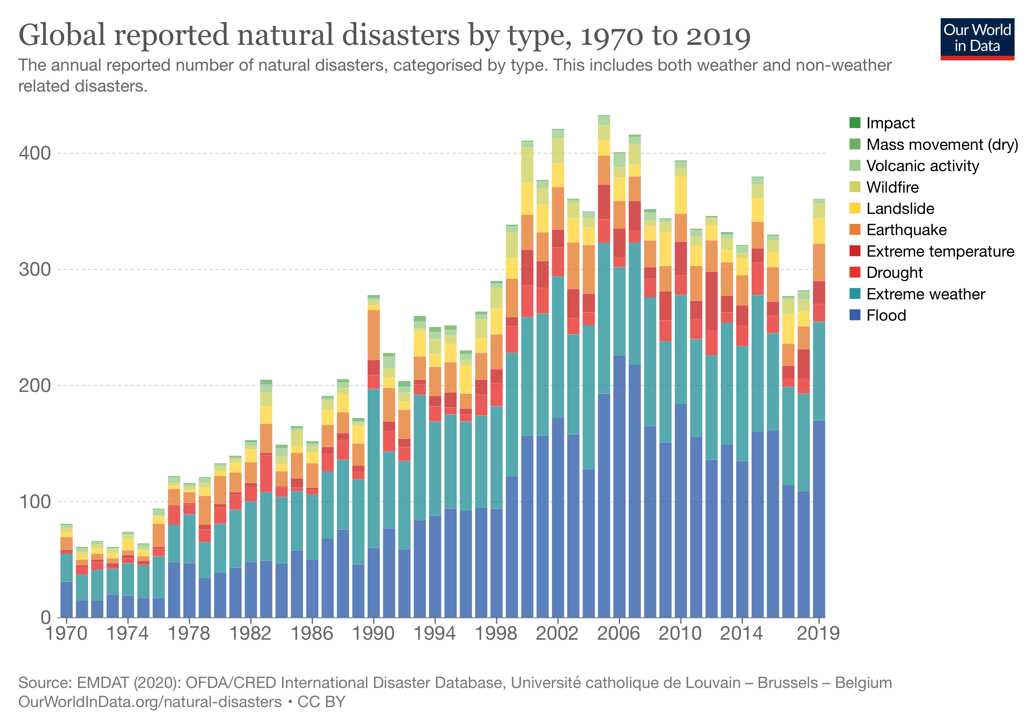
Notes:
According to the Germanwatch Global Climate Risk Index 2021, between 2000 and 2019 more than 475,000 people died as a direct result of more than 11,000 extreme weather events, with economic losses amounting to ca. US$ 2.6 trillion (in PPP).

Slide 10
The 20 most damaging natural disasters, 1998-2019
Country | Year | Type | Name | Damages (% of GDP) | Disaster-prone country | Small economy
Dominica | 2017 | Storm | Hurricane Maria | 260.0 | Yes | Yes*
Grenada | 2004 | Storm | Hurricane Ivan | 148.0 | Yes | Yes*
Dominica | 2015 | Storm | Tropical Storm Erika | 90.2 | Yes | Yes*
Honduras | 1998 | Storm | Hurricane Mitch | 72.9 | No | No
The Bahamas | 2019 | Storm | Hurricane Dorian | 66.0 | Yes | Yes*
Guyana | 2005 | Flood | N.A. | 35.5 | No | Yes*
Belize | 2000 | Storm | Hurricane Keith | 33.4 | Yes | Yes*
Tonga | 2001 | Storm | Tropical Cyclone Waka | 29.0 | Yes | Yes*
Belize | 2001 | Storm | Hurricane Iris | 28.7 | Yes | Yes*
Haiti | 2016 | Storm | Hurricane Matthew | 25.1 | Yes | Yes**
Nicaragua | 1998 | Storm | Hurricane Mitch | 21.3 | No | No
Samoa | 2012 | Storm | Cyclone Evan | 16.6 | Yes | Yes*
Tajikistan | 2008 | Ex. Temp. | N.A. | 16.3 | Yes | Yes**
Mozambique | 2019 | Storm | Tropical Cyclone Idai | 16.0 | Yes | Yes**
Fiji | 2016 | Storm | Tropical Storm Winston | 12.9 | Yes | Yes*
Myanmar | 2008 | Storm | Cyclone Nargis | 12.6 | No | No
Guyana | 2006 | Flood | N.A. | 11.6 | No | Yes*
Thailand | 2011 | Flood | N.A. | 10.9 | No | No
Source: Volz et al. (2020).

Slide 11
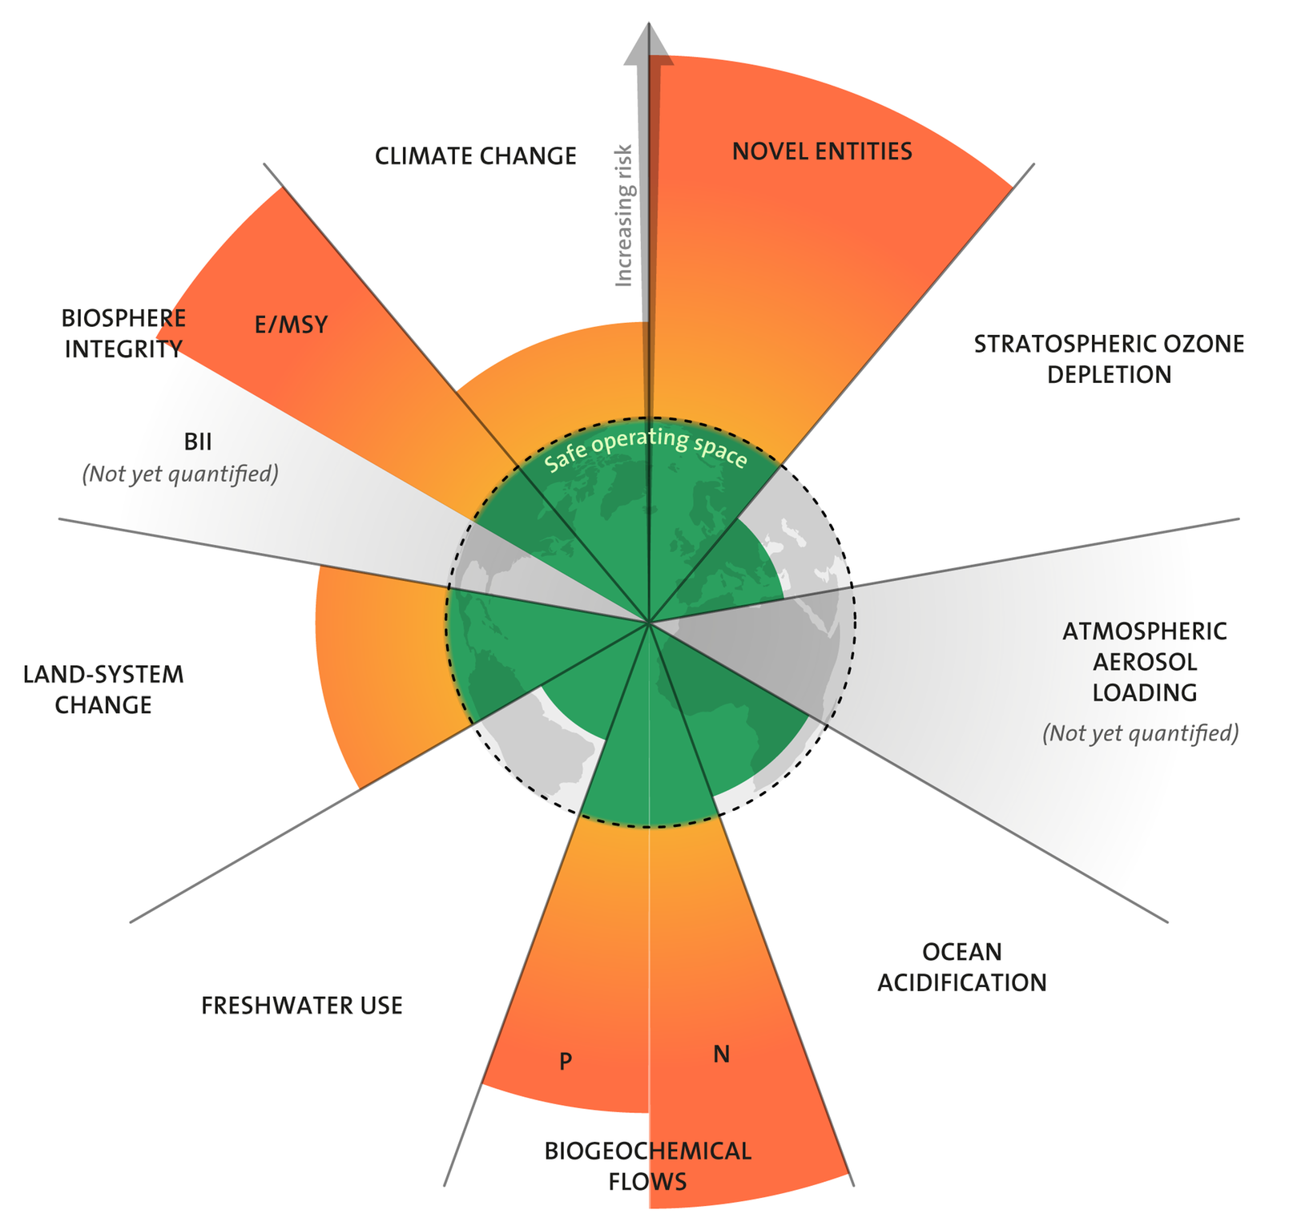
Planetary boundaries
E/MSY: extinctions per million species-years
BII: Biodiversity Intactness Index
Source: Azote for Stockholm Resilience Centre, based on analysis in Persson et al. (2022) and Steffen et al. (2015).
Notes:
Planetary boundaries is a concept involving Earth system processes that contain environmental boundaries.
It was proposed in 2009 by a group of Earth system and environmental scientists
The idea was to define a "safe operating space for humanity" as a precondition for sustainable development.
The framework is based on scientific evidence that human actions since the Industrial Revolution have become the main driver of global environmental change.
According to the paradigm, "transgressing one or more planetary boundaries may be deleterious or even catastrophic due to the risk of crossing thresholds that will trigger non-linear, abrupt environmental change within continental-scale to planetary-scale systems.

Slide 12
Climate change threatens biodiversity globally, on land and in the ocean
Terrestrial biodiversity is suffering from climate shifts, with 14% local species loss on average predicted already at 1–2°C warming, and more than one-third in a business-as-usual scenario.
Coral reefs – marine biodiversity hotspots – are at high risk of extinction, due to ocean acidification, warming, heatwaves, and other anthropogenic pressures.
  At 2°C warming, at least 99% of coral reefs will disappear together with their ecosystem services, which sustain over 0.5 billion people at present.
Rising water temperatures increase the risk of decreasing fish populations due to changes in marine food webs.
  In freshwater ecosystems, fish die-offs may double by 2050 and increase fourfold towards the end of the century due to extreme summer temperatures.
Natural climate solutions are an essential contribution to mitigation, but nowhere near enough to ensure climate stability.
Source: Pihl et al. (2019).

Slide 13
Intergovernmental Science-Policy Platform on Biodiversity and Ecosystem Services’ 2019 Global Assessment Report on
Biodiversity and Ecosystem Services
IPBES Chair, Sir Robert Watson: “The health of ecosystems on
which we and all other species depend is deteriorating more
rapidly than ever. We are eroding the very foundations of our
economies, livelihoods, food security, health and quality of life
worldwide.”
75% of terrestrial environment “severely altered” to date by
human actions and 66% of marine environments.
More than a third of the world’s land surface and nearly 75% of freshwater resources are now devoted to crop or livestock production.
Land degradation has reduced the productivity of 23% of the global land surface, up to $577 billion in annual global crops are at risk from pollinator loss and 100-300 million people are at increased risk of floods and hurricanes because of loss of coastal habitats and protection.
Source: (IPBES (2019).

Slide 14
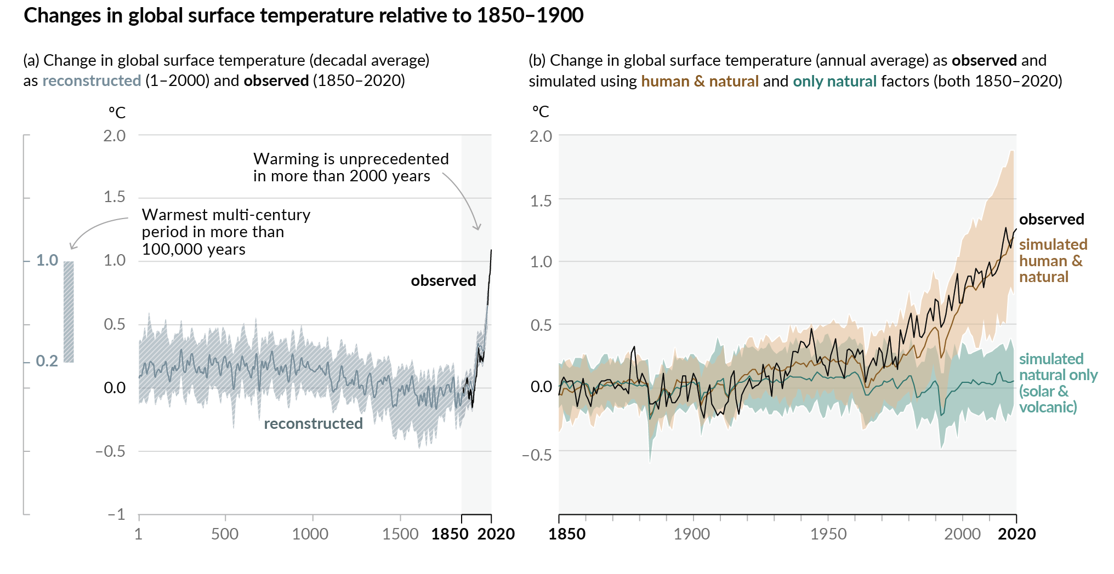
Human influence has warmed the climate at a rate that is unprecedented in at least the last 2000 years
Source: IPCC (2021), Sixth Assessment Report, Working Group 1: The Physical Science Basis.
Notes:
Figure: History of global temperature change and causes of recent warming
left Panel: Changes in global surface temperature
the world is currently 1.1 degree Celsius warmer than the pre-industrial years.
The vertical bar on the left shows the estimated temperature (very likely range) during the warmest multi-century period in at least the last 100,000 years, which occurred around 6500 years ago.
The Last Interglacial, around 125,000 years ago, is the next most recent candidate for a period of higher temperature. These past warm periods were caused by slow (multi-millennial) orbital variations.
Right Panel: Changes in global surface temperature over the past 170 years (black line) relative to 1850–1900 and annually averaged, compared to Coupled Model Intercomparison Project Phase 6 (CMIP6) climate model simulations (see Box SPM.1) of the temperature response to both human and natural drivers (brown) and to only natural drivers (solar and volcanic activity, green). Solid coloured lines show the multi-model average, and coloured shades show the very likely range of simulations.

Slide 15
A rapidly closing window of opportunity for climate action
The science is unequivocal: Climate change endangers the well-being of people and the planet.
Delayed action risks triggering impacts of climate change so catastrophic our world will become unrecognizable.
The next few years offer a narrow window to realize a sustainable, liveable future for all.
Changing course will require immediate, ambitious and concerted efforts to slash emissions, build resilience, conserve ecosystems, and dramatically increase finance for adaptation and addressing loss and damage.

Slide 16
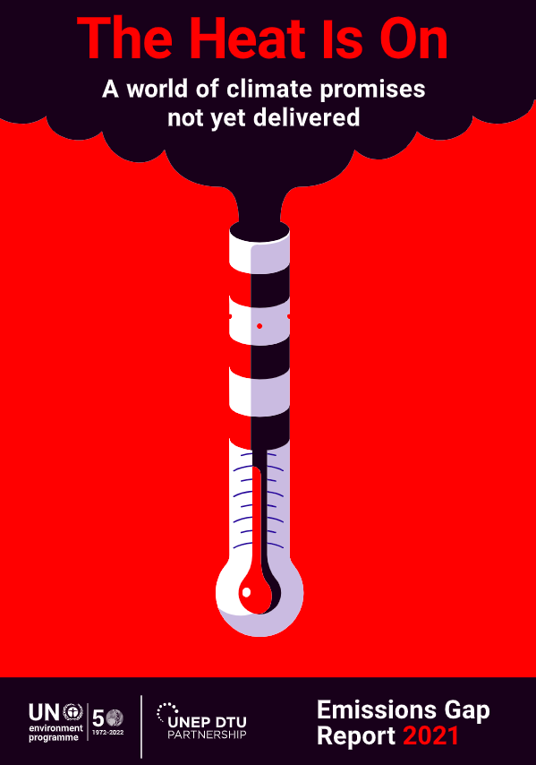
“To keep global warming below 1.5°C this century, the aspirational goal of the Paris Agreement, the world needs to halve annual greenhouse gas emissions in the next eight years.”

Slide 17
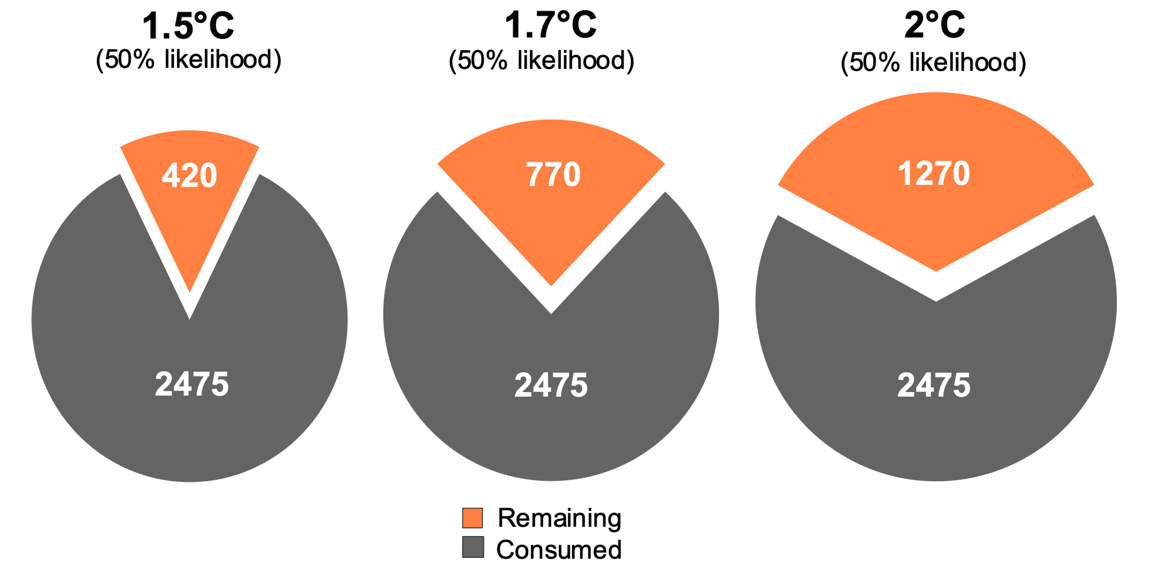
Remaining global carbon budget
The remaining carbon budget to limit global warming to 1.5°C , 1.7°C and 2°C is
420 GtCO₂, 770 GtCO₂, and 1270 GtCO₂ respectively, equivalent to 11, 20 and 32 years from 2022.
2475 GtCO₂ have been emitted since 1750
Quantities are subject to [additional] uncertainties e.g., future mitigation choices of non-CO₂ emissions.
Source: IPCC AR6 WG1; Friedlingstein et al. (2021); Global Carbon Budget 2021.
Notes:
Carbon Tracker, the NGO, estimates that at the end of 2021, the world has a carbon budget of 420 GtC02 left for a 50% chance of success of staying below 1.5C of global warming and avert catastrophic climate change.
This is the amount of carbon the world can still burn within the 1.5C degree target. At the current rate of carbon emissions, this carbon budget is exhausted in 2033.
So if we are serious about cutting emissions and achieving the goal of limiting global warming to 1.5C – or 2C for that matter, then there is a bit more carbon budget left – then clearly this has implications for the fossil fuel sector and its valuation.

Slide 18
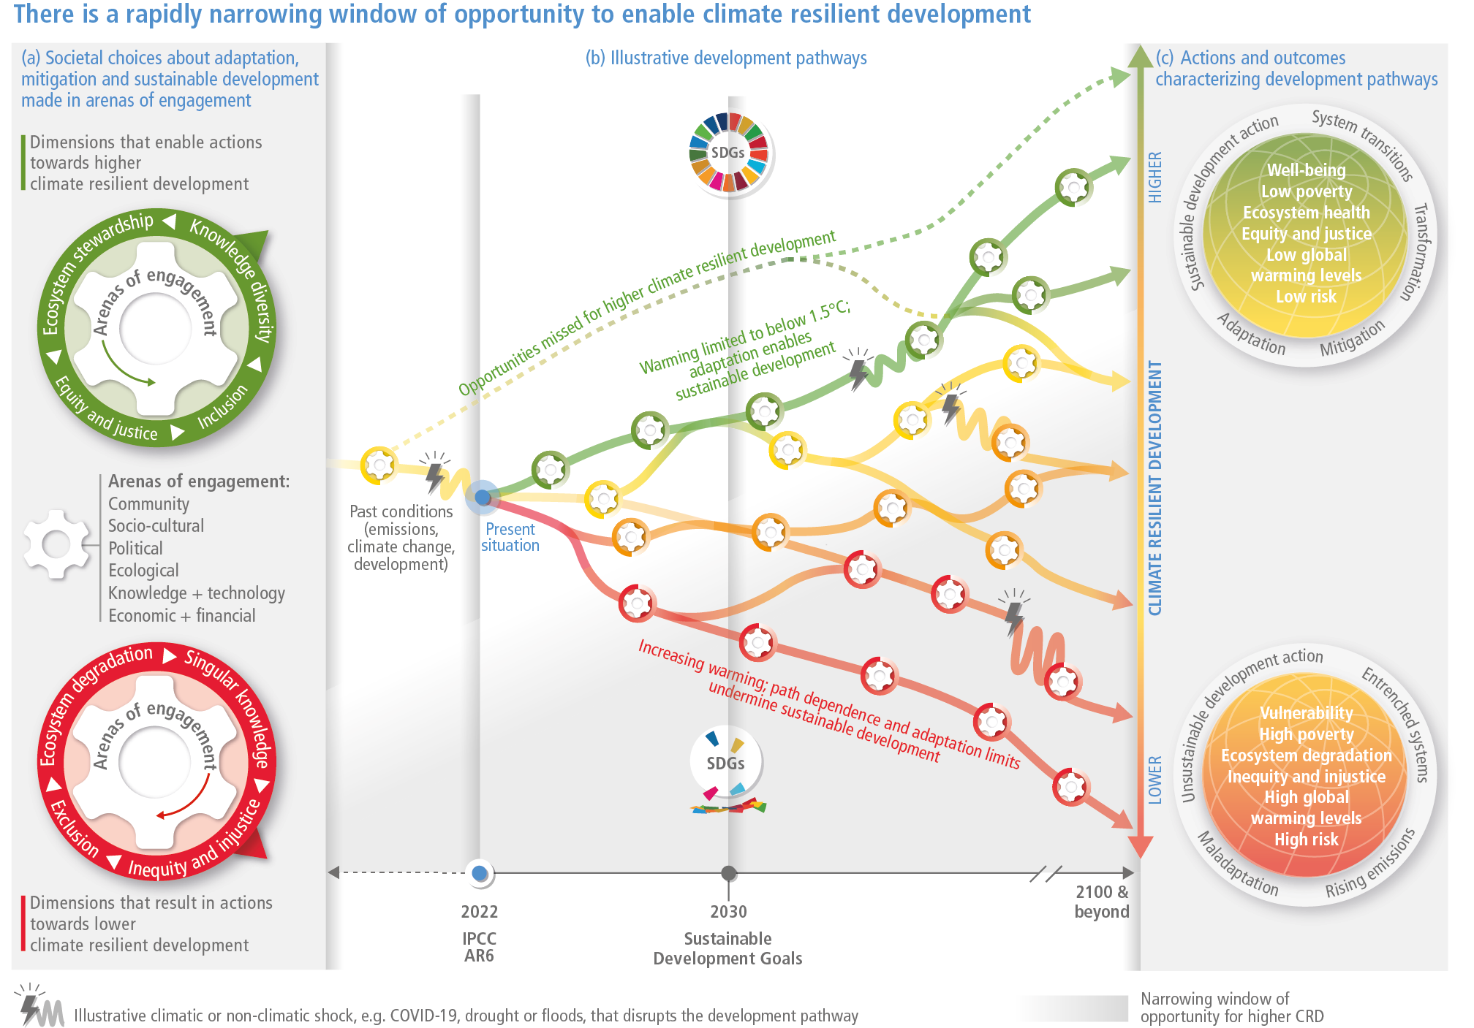
Source: IPCC (2022), Sixth Assessment Report, Working Group 2: Impacts, Adaptation and Vulnerability.

Slide 19
What does finance have to do with this?

Slide 20
Source: Bank of England (2018).
Notes:
Finance sits at the hart of the global economy allocating capital and managing risks
Climate change creates physical risks and transition risks

Slide 21
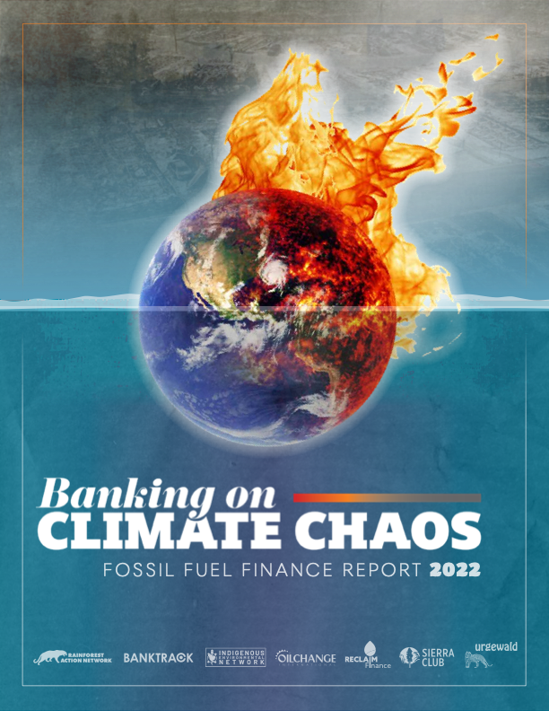
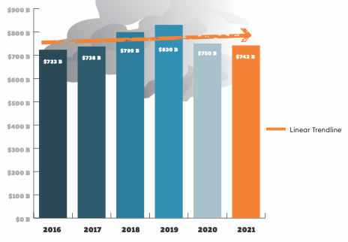
Lending and underwriting from the world’s 60 biggest banks to the fossil fuel sector
$4.6 trillion since the signing of the Paris Agreement!
Source: Rainforest Action Network (2022).
Notes:
We clearly have more awareness among investors and banks. But does this translate into practice?
The Rainforest Action Network – a coalition of NGOs – keeps track of the actions of the financial sector, and these doesn’t always look very sustainable.
In the six years since the adoption of the Paris Agreement, the world’s 60 largest private sector banks financed fossil fuels with USD $4.6 trillion, according to a report by the Rainforest Action Network.
Despite the Covid-19 pandemic cutting energy use, the finance provided in 2020 was higher than in 2016 or 2017.

Slide 22
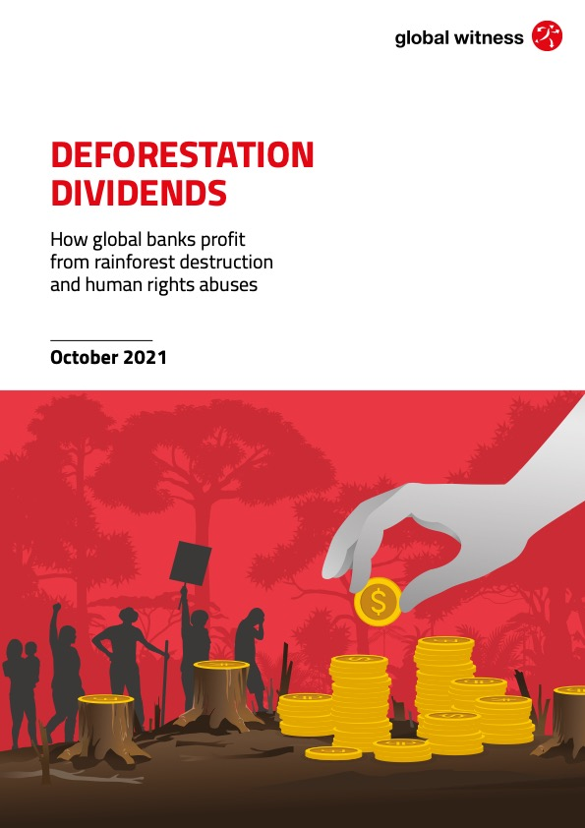
Source: Global Witness (2021).
Banks and asset managers based in the EU, UK, US and China have made deals worth $157 billion with firms accused of destroying tropical forest in Brazil, Southeast Asia and Africa since the Paris Climate Agreement.
Notes:
Banks and asset managers based in the EU, UK, US and China have made deals worth $157 billion with firms accused of destroying tropical forest in Brazil, Southeast Asia and Africa since the Paris Climate Agreement

Slide 23
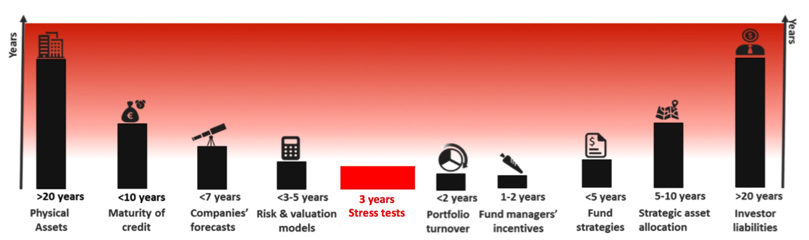
Short-termism
Notes:
But one of the major problems is that CC is a longer-term problem, even though we are already seeing quite dramatic effects now.
A crucial problem is that even though we know what is facing us, in current financial market decisions these longer effects are not accounted for.
But today’s financing decisions have long-term impact. Historically, coal plants have retired at an average lifetime of 46 years globally, but in many cases they can operate for 50–60 years or longer.
As former BoE Governor MK pointed out, there is a Tragedy of the Horizons, because we know the major impacts of CC will be felt over the longer time horizon and this is not included in the financial models, in the risk models, portfolio models of the financial sector.
So we have a divergence between a very short-term focus of lending and investment and longer-term impacts of CC. And this mismatch needs to be addressed. We need to have this longer-term perspective embedded in finance.

Slide 24
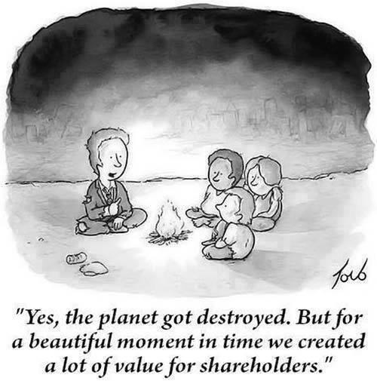
Notes:
Some of you may have seen this cartoon already: “…”
And this really captures the problem -- the short-termistic nature of finance. You will be familiar with the concept of shareholder value, which has been the dominant paradigm over the last decade.
The shareholder value paradigm basically says that the main purpose of companies is to create shareholder value. Shareholder value is measured by stock prices, so investors are focusing on short-term stock piece developments, and that is what is guiding management, and long-term perspectives are largely ignored.
But that is of course not the way to create long-term value for your company, or long-term value for your society. It is value creation that really needs to be at the heart of finance. Finance needs to support the real economy. This is what sustainable finance really ought to be about.
To achieve sustainable and low-carbon development, large investments are needed in renewable energy generation, resource and energy efficiency, smart transportation networks, and many other areas that will help the shift towards sustainable patterns of production and consumption.
Even though targeted public finance will be crucial in supporting the ‘green transformation’, large parts of the necessary financing must come from private sources. We also need to scale up investment in resilience to climate-proof our economies.
It is of utmost importance that the financial sector accounts properly for environment- and climate-related as well as social risks and impacts. It is therefore crucial that those who govern financial markets, that is central banks and financial supervisors, make sure that finance becomes aligned with climate and sustainability goals.
The good news is that there are already numerous examples for public initiatives aimed at aligning the financial system with sustainable development as well as examples of innovative green financial products and services developed by the financial sector. But much more needs to be done. And this is why it is so important that bank Negara Malaysia and other central banks take decisive action.

Slide 25
Climate-related financial and macroeconomic risks

Slide 26
“Changes in climate policies, new technologies and growing physical risks will prompt reassessments of the values of virtually every financial asset. Firms that align their business models to the transition to a net zero world will be rewarded handsomely. Those that fail to adapt will cease to exist.”
– Mark Carney, UN Special Envoy on Climate Action and Finance
Governor of the Bank of England, 2013-2020
Chair of the Financial Stability Board 2011-2018
Notes:
Here’s a quote from Mark Carney, the former governor of the Bank of England and Chair of the Financial Stability Board, who was instrumental in advancing the debate on climate in the financial sector and among supervisors.
He says: “Changes in climate policies, new technologies and growing physical risks will prompt reassessments of the values of virtually every financial asset. Firms that align their business models to the transition to a net zero world will be rewarded handsomely. Those that fail to adapt will cease to exist.”
Basically, we need each and every organization to consider how they will be affected by climate change, and how they can adapt to the new realities. Those who don’t do that, will fail.

Slide 27
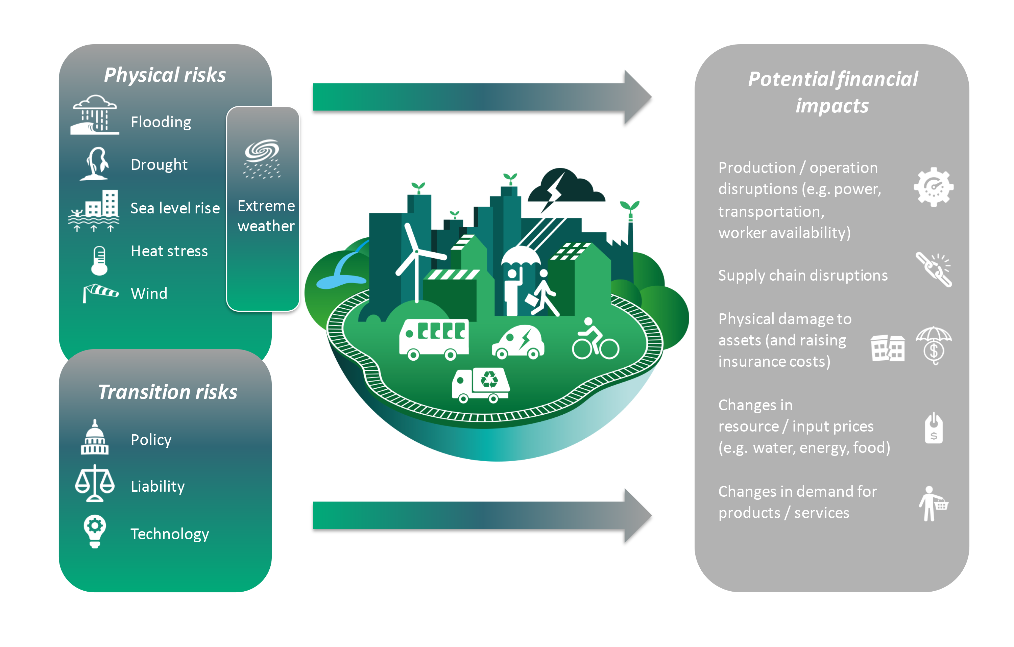
Potential economic
impacts
Source: Center for International Climate Research (2020).

Slide 28
The economy faces physical and transition risks due to climate change
Green scenario
Carbon-intensive scenario
 | Rapid Transition | Two-degree | Business-as-intended | Business-as-usual
Corrective transition response | Very strong | Strong | Substantial | Limited
Change in temperature vs. pre‑industrial era | 1.5°C | 2°C | 3°C | 4°C
% fossil fuel in energy mix (2050) | <40% | <50% | >75% | >80%
More transition risk
More physical risk
Risks associated with obsolescence of ‘dirty’ businesses due to transition to a green economy
Controlled yet aggressive change
Major short term impact but reduced long‑term impact; lowest economic damage
Physical damage to assets due to climate events that impair profitability of financial sector firms
Accelerating changes in earth system impacts
Impacts continue to increase over time
Economic damages increase
Source: Mercer/Oliver Wyman.

Slide 29
From climate risks to financial risks
Source: NGFS (2020).

Slide 30
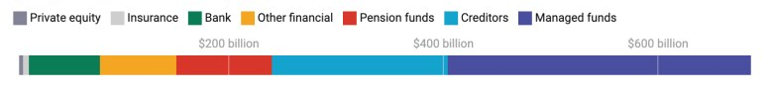
Global losses from stranded assets for the financial sector
Source: Semieniuk et al. (2022).

Slide 31
Is ESG the answer?

Slide 32
What is ESG?
“ESG investing resists precise definition, but roughly speaking it is an umbrella term that refers to an investment strategy that emphasizes a firm’s governance structure and the social and environmental impacts of the firm’s products or practices.” (Schanzenbach & Sitkoff, 2018)
ESG is an investment screen.
Notes:
What is ESG?
ESG stands for environmental, social and governance.
It is an umbrella term that refers to an investment strategy that emphasizes a firm’s governance structure and the social and environmental impacts of the firm’s products or practices.
ESG can also be described as an investment screen.

Slide 33
ESG criteria
Environmental governance
Greenhouse gas emissions, biodiversity, waste management, water management, …
Social concerns
Diversity, human rights, consumer protection, animal welfare, …
Corporate governance
Management structure, employee relations, executive compensation, employee compensation, …
Notes:
For each of the three ESG criteria, there are numerous variables of interest.

Slide 34
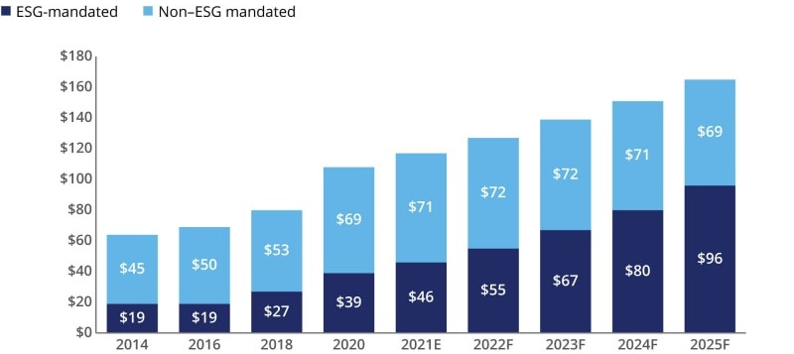
Global assets under professional management
(US$ trillion)
Source: Deloitte (2022), with data from the Global Sustainable Investment Alliance.

Slide 35
Comparison of ESG evaluation by FTSE and MSCI
Notes: Universe for the analysis are 430 Japanese companies commonly surveyed FTSE and MSCI (as of July 2016); The plot of the diagram shows the ranking of ESG evaluation of each company (from 1st to 430th)
Source: GPIF, https://www.gpif.go.jp/en/investment/pdf/ESG_indices_selected.pdf
Notes:
A further problem is the measurement of ESG performance.
There is a growing number of providers of ESG rankings. However, the problem is that their methodologies are not reliable.
In this chart you see a comparison of ESG evaluation of 430 Japanese companies commonly surveyed FTSE and MSCI, two of the major ESG ratings providers. You can see that there is no correlation whatsoever. Some companies were rated highly by one but low by the other and vice versa.

Slide 36
ESG ratings of select companies by different raters
Source: Adapted from Dimson et al. (2020).
Notes:
Here you can see the ESG ratings of selected companies by different raters, again showing very substantial differences.
It is not hard to see that basing your investment decisions on such ESG ratings is problematic.
What is actually green or sustainable? This is why green or sustainable taxonomies are so important that clarify what can be counted as green or sustainable.

Slide 37
Financial world greenwashing the public with deadly distraction in sustainable investing practices
“The financial services industry is duping the American public with its pro-environment, sustainable investing practices. This multitrillion dollar arena of socially conscious investing is being presented as something it’s not. In essence, Wall Street is greenwashing the economic system and, in the process, creating a deadly distraction. I should know; I was at the heart of it.
As the former chief investment officer of Sustainable Investing at BlackRock, the largest asset manager in the world with $8.7 trillion in assets, I led the charge to incorporate environmental, social and governance (ESG) into our global investments. In fact, our messaging helped mainstream the concept that pursuing social good was also good for the bottom line. Sadly, that’s all it is, a hopeful idea. In truth, sustainable investing boils down to little more than marketing hype, PR spin and disingenuous promises from the investment community.”
Tariq Fancy, former Chief Investment Officer of Sustainable Investing at BlackRock
Source: https://eu.usatoday.com/story/opinion/2021/03/16/wall-street-esg-sustainable-investing-greenwashing-column/6948923002/
Notes:
Given the problems with ESG ratings, it is not surprising that there have been serious issues with greenwashing.
Greenwashing means that companies seek to evoke the impression that they are green or sustainable while in fact they are not.
Here is a quote by Tariq Fancy, the former Chief Investment Officer of Sustainable Investing at BlackRock, the world's largest asset manager, with currently US$10 trillion in assets under management.
He says:
“The financial services industry is duping the American public with its pro-environment, sustainable investing practices. This multitrillion dollar arena of socially conscious investing is being presented as something it’s not. In essence, Wall Street is greenwashing the economic system and, in the process, creating a deadly distraction.”
“In truth, sustainable investing boils down to little more than marketing hype, PR spin and disingenuous promises from the investment community.”

Slide 38
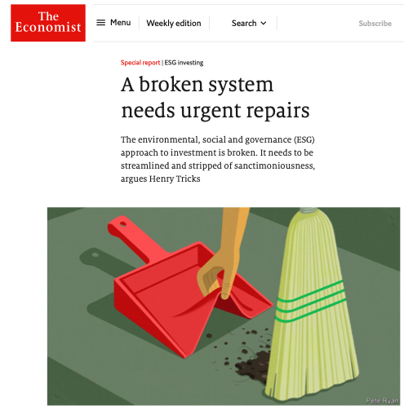

Slide 39
Financial institutions with $130trn in assets
have committed to net-zero by 2050.
Source: https://www.unep.org/news-and-stories/press-release/mark-carney-un-race-zero-campaign-cop26-presidency-launch-net-zero
Notes:
We have recently seen a growing number of commitments and net zero initiatives across the financial system to accelerate the transition to net zero emissions by 2050 at the latest.
In April 2021, the Glasgow Financial Alliance for Net Zero (GFANZ) was launched, bringing together over 160 firms that together are responsible for assets in excess of US$70 trillion. GFANZ is chaired by Mark Carney, the UN Special Envoy on Climate Action and Finance.
Also in April, 43 banks from 23 countries with assets of US$28.5 trillion formed the Net-Zero Banking Alliance - which joined GFANZ - with its members committing to align operational and attributable emissions from their portfolios with pathways to net-zero by 2050 or sooner. In Malaysia, CIMB Bank Berhad is a member of the the Net-Zero Banking Alliance .
This is very laudable and encouraging. At the same time it is important to realise that all these great announcements often stand in stark contrast to the actions taken by the same institutions today.
For full disclosure: I am on the advisory panel for GFANZ, which is an unenumerated position.

Slide 40
Governing sustainable finance

Slide 41
“As guardians of the financial system, central banks and financial supervisors need to introduce explicit strategies to support the transition to net-zero.”

Slide 42
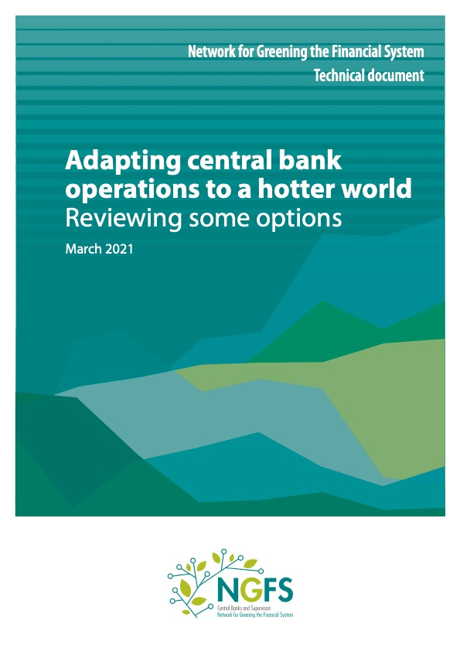
“While we cannot take on the tasks of governments, we also cannot be mere bystanders in the transition to a net zero economy. It is our responsibility to take on the challenge we are facing as publicly accountable institutions, serving our societies.”
Frank Elderson, Chair of the NGFS
Sabine Mauderer, Chair of theNGFS workstream “Scaling up Green Finance”

Slide 43
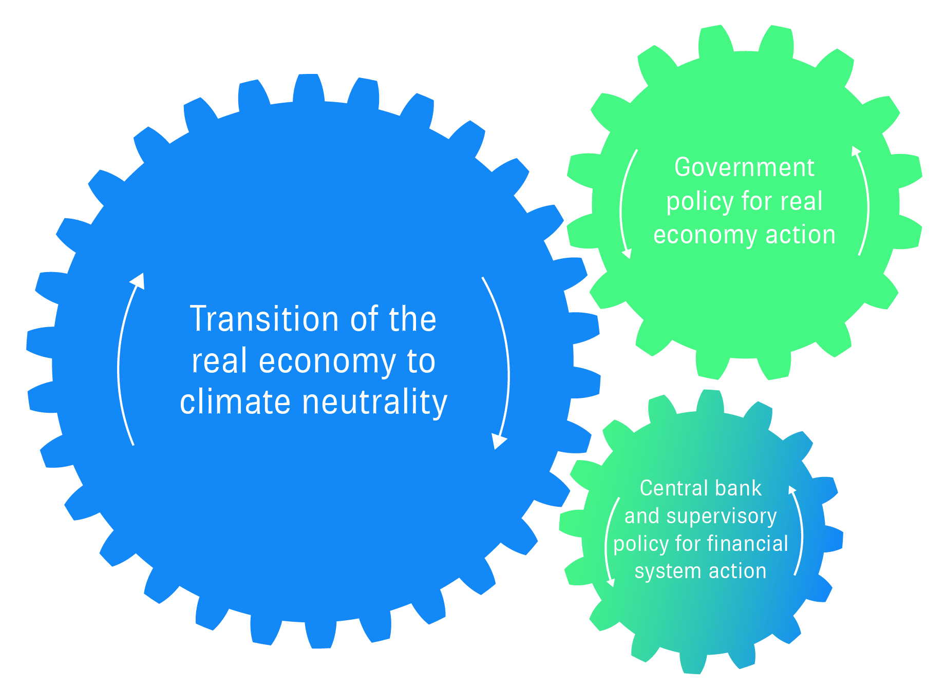
Source: Dikau, Robins and Volz (2021).

Slide 44
Monetary and financial authorities are increasingly introducing sustainable finance policies and frameworks
Disclosures
Taxonomies
Scenario analysis and climate stress tests
Prudential frameworks
Sustainable and responsible management of central banks’ portfolios
Monetary policy instruments to scale-up sustainable finance

Slide 45
Financial system structure matters
Financial system structure influences outcomes such as access to finance by firms, the cost of finance, financial stability and the provision of sustainable finance.
There is no optimal financial system structure that will work best for all countries at all times.
Yet there seem to be certain characteristics of financial systems that seem to be associated with better real economy outcomes such as enhanced access to finance by (small and medium) firms, lower cost of finance and greater system resilience.

Slide 46
Financial system characteristics & outcomes
Access to finance by firms and households
Cost of finance
Financial stability
Real economy development
Sustainable finance
Financial system size
Market concentration
System diversity
Type and mandate of financial institutions
Size of institutions
Volz (2015).

Slide 47
Terima kasih!

