Slide 1
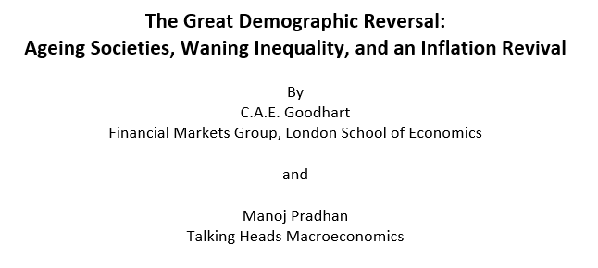

Slide 2
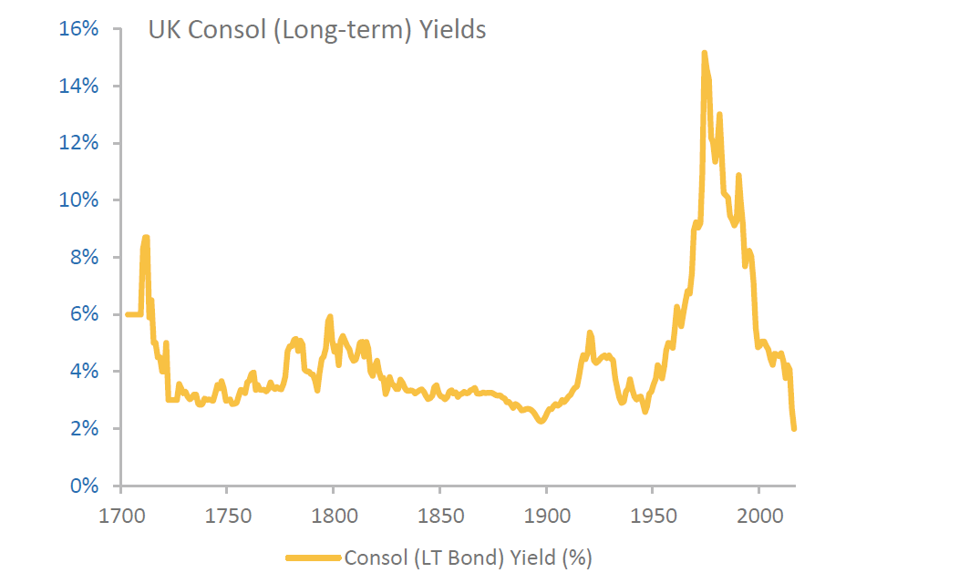
Figure 1: Interest rates have been falling for decades

Slide 3
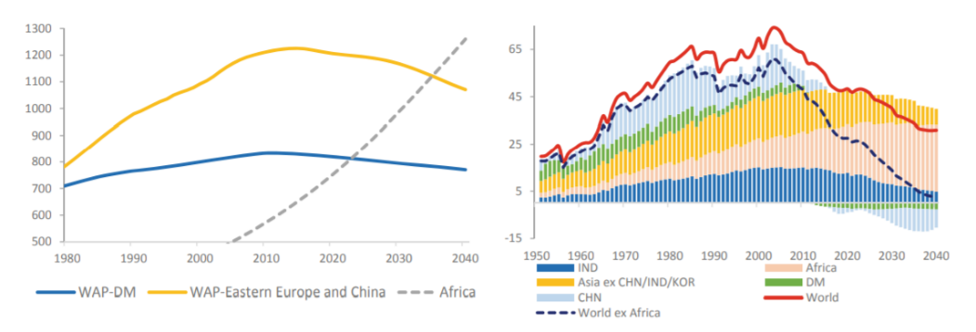
Figure 2: Working age populations falling globally – Africa is the key exception,
and India to a lesser extent

Slide 4
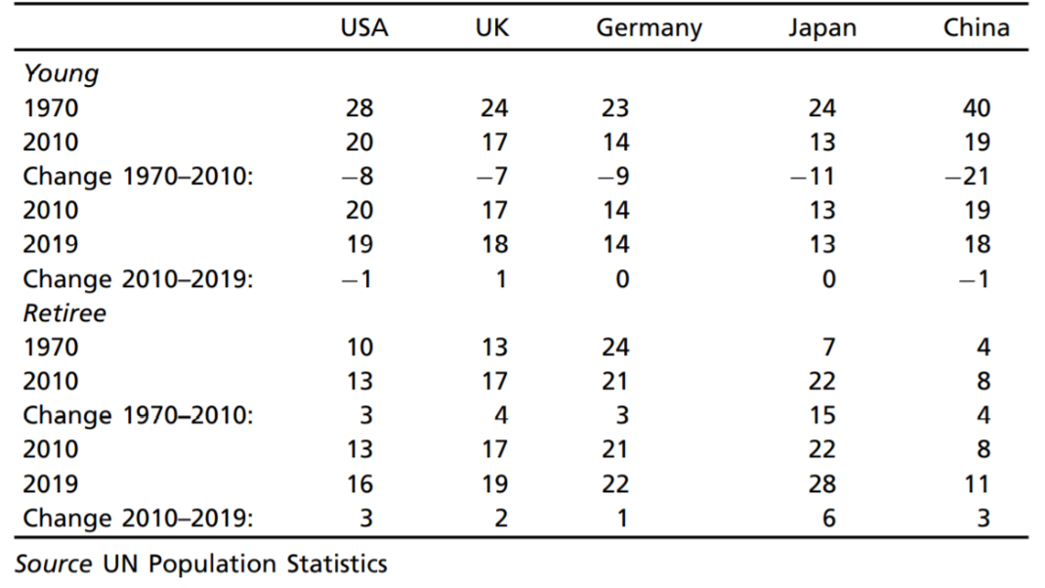
Table 1: Dependency ratios rising because of the elderly, not the young

Slide 5
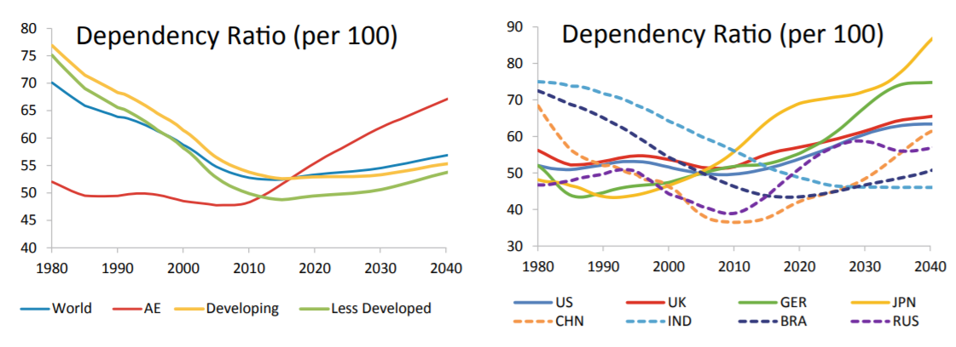
Figure 3: The ‘dependency ratio’ is rising in the AEs and EME giants – except India

Slide 6
China – A Historic Mobilization Ends
China’s integration in the global economy:
WTO accession, internal migration, financial repression of households to subsidize SOEs
Today:
Labour: China is past the ‘Lewis Point’
Capital: Inflow of companies, and hence technology, is harder
Economic model and external environment have been transformed
The Result?
China is no longer a global disinflationary force
Falling savings (due to ageing) will push the current account into deficit
Technological change will have to be generated at home.

Slide 7
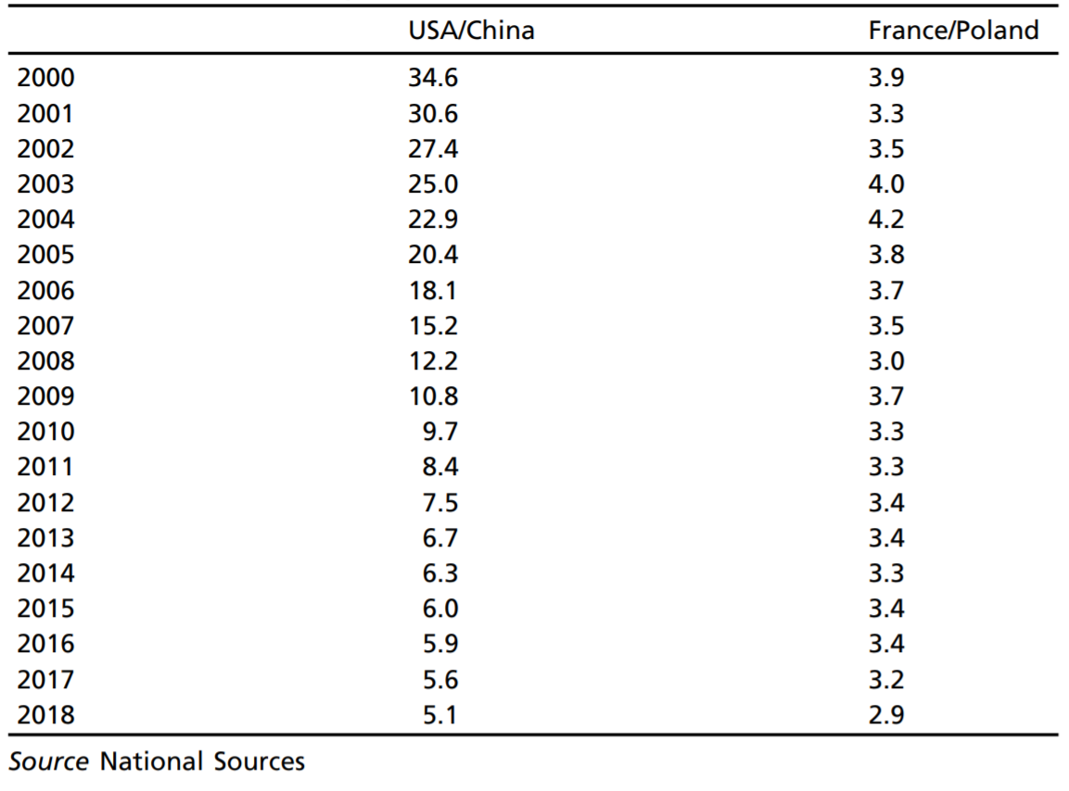
Table 2: Inequality has narrowed across countries, particularly the EMEs
Ratio of the wages of the workers

Slide 8
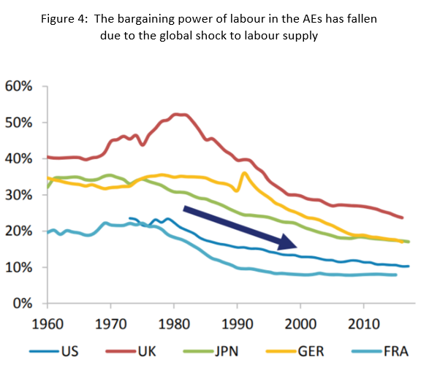

Slide 9
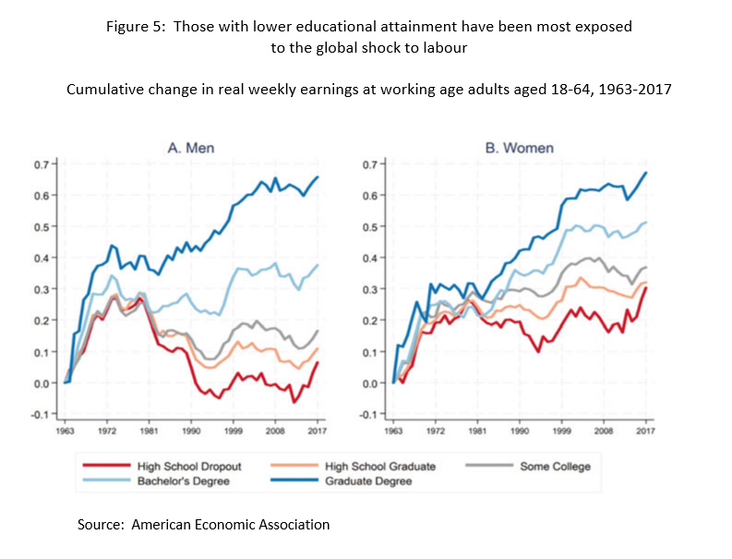

Slide 10
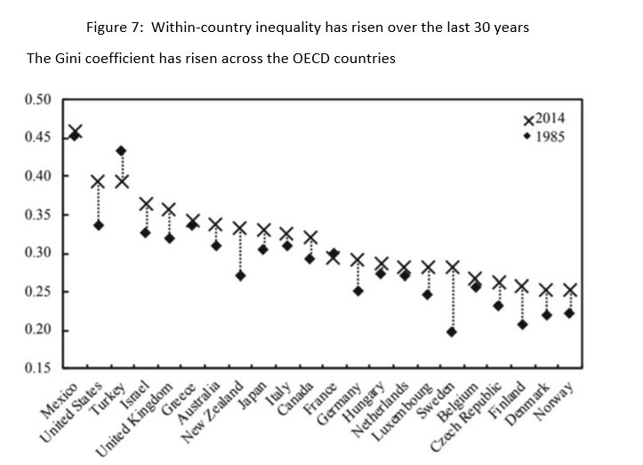
Figure 6: Within-country inequality has risen over the last 30 years

Slide 11
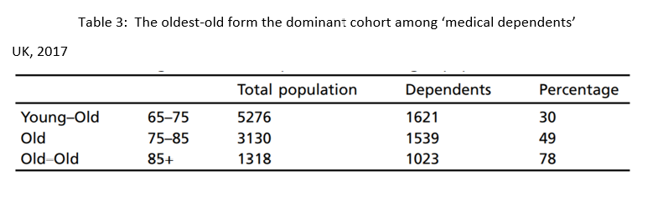

Slide 12
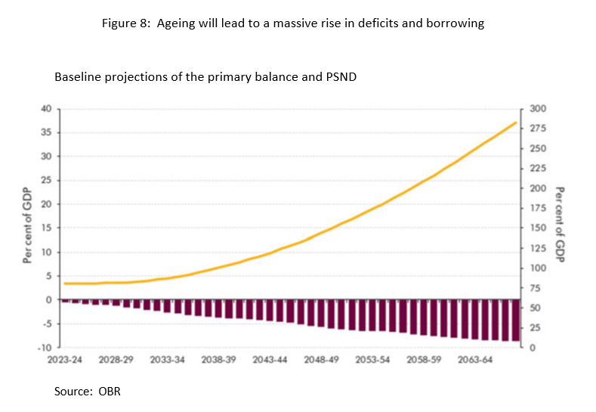
Figure 7: Ageing will lead to a massive rise in deficits and borrowing

Slide 13
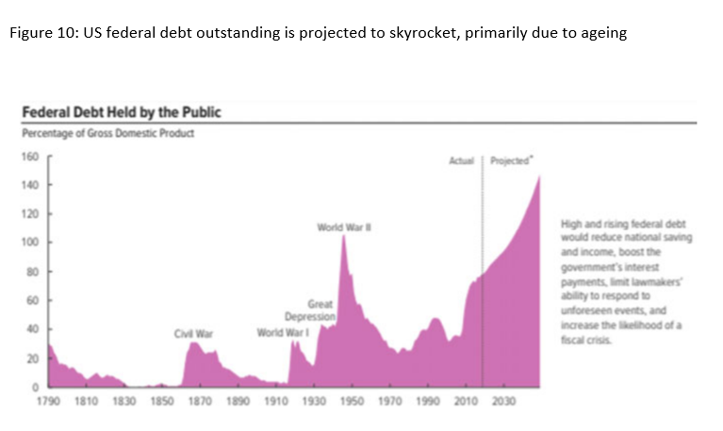
Figure 8: US federal debt outstanding is project to skyrocket, mostly due to ageing

Slide 14
Mitigants
  Africa/India
  Limit benefits to old
  More participation of elderly
  Technology

Slide 15
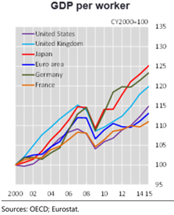
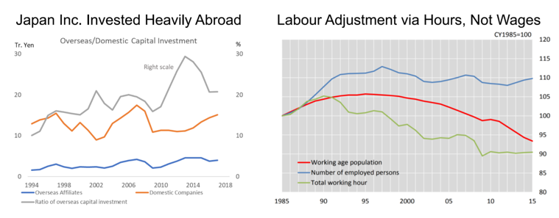
Figure 9: “Why Didn’t It Happen in Japan?”

Slide 16
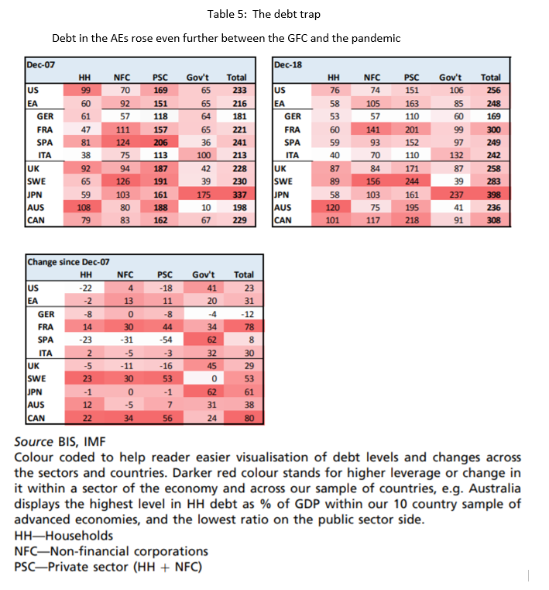

Slide 17
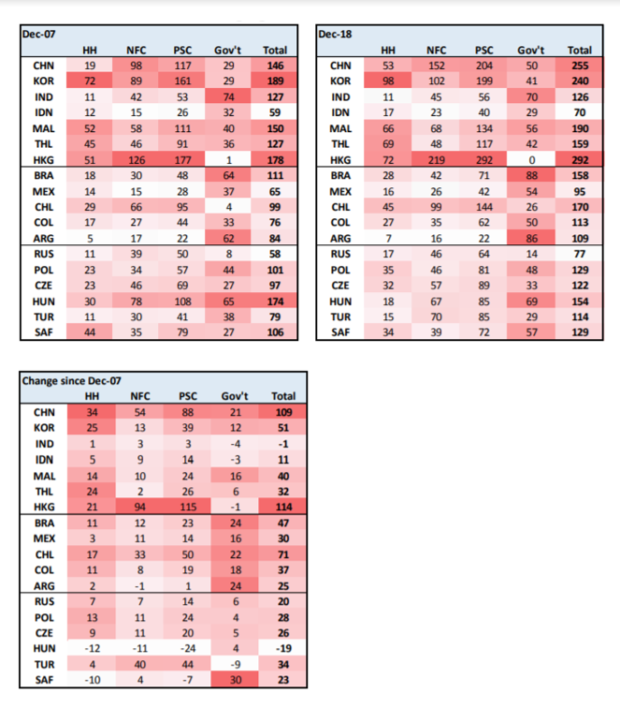

Slide 18
Conclusions
  Inflation is coming – and the coronavirus will accelerate its arrival
  The interest rate yield curve will steepen
  Asset returns will be harder to extract
  The combination will lead to lower within-country inequality
  The Debt Trap will have to be dealt with
  Higher taxes will finance age-related spending
    Corporations
    Land (Henry George)
    Carbon
  Central bank independence will come under increasing threat

