Slide 1
The impacts of inflation on income inequality: The role of institutional quality
23 Nov 2022
Dr. Law Chee Hong

Slide 2
Income inequality in 2019
Income inequality in 2019
Source: https://ourworldindata.org/income-inequality

Slide 3
Introduction
The income inequality has numerous economic and social effects.
Among the determinants of income inequality investigated in the previous studies are:
Economic development level (Monnin, 2014).
Unemployment (Monnin, 2014).
Institutional factors (Amendola, Easaw & Savoia, 2013)
Monetary policy (interest rate) (Colciago et al. 2019).
Inflation rate (Colciago et al. 2019).

Slide 4
Introduction
The focus of the paper is inflation
Previous studies such as Monnin (2014), Narob (2015), Balcilar, Chang, Gupta, and Miller (2018), Siami-Namini and Hudson (2019) has find either linear or nonlinear impacts of inflation.
Theoretical impacts of inflation on income inequality
1) Increase income inequality by lower purchasing power of the poor and real value of government aids (regressive tax).
2) Reduce income inequality by inflating nominal income and lead to higher income tax (progressive tax)

Slide 5
Introduction
The objectives of the paper are:
To study the inflation-income inequality nexus using panel data.
The role of institutional quality in that nexus.
Rationale of the second objective:
Better institutional quality will tend to offer inclusive economic planning and promote a more equal income distribution
According to Law, Tan and Azman-Saini (2014), the poor are more protected in a well-design institutional framework.

Slide 6
Methodology and Data
Uses the two-step System GMM estimator to tackle the effect persistency.
Deploys an unbalanced panel set (4-year non-overlapping average data from 1987 to 2014) from 65 developed and developing countries.
Note 1: orthogonise the interaction term to avoid strong correlations between interaction term and its components. This is done by regressing interaction term on LINS and INF_CPI. The residual will be used for estimation.
Note 2: Outliers are identified by using the Cook’s distance outlier test and excluded from the test.

Slide 7
Methodology and Data
Algeria | Chile | Germany | Israel | Netherlands | Singapore | Uganda
Argentina | China | Ghana | Italy | New Zealand | South Africa | United Kingdom
Australia | Colombia | Greece | Japan | Niger | Spain | United States
Austria | Costa Rica | Honduras | Jordan | Norway | Sri Lanka | Uruguay
Bangladesh | Cyprus | Hong Kong, China | Korea, Rep. | Pakistan | Sweden | Zambia
Belgium | Denmark | Hungary | Luxembourg | Peru | Switzerland
Bolivia | Egypt, Arab Rep. | Iceland | Malawi | Philippines | Tanzania
Brazil | Finland | India | Malaysia | Portugal | Thailand
Cameroon | France | Indonesia | Mexico | Qatar | Tunisia
Canada | Gambia, The | Ireland | Morocco | Sierra Leone | Turkey

Slide 8
Methodology and Data
Variables | Unit of Measurement | Data Source
Income inequality index (post-tax and post-transfer) | Index | Standardised World Income Inequality database
Inflation (annual change of CPI) | % | World Development Indicator databank
International Country Risk Guide | Index | PRS group
Unemployment rate | % | World Development Indicator databank
the ratio of the merchandise trade to GDP | (% of GDP) | World Development Indicator databank
the ratio of domestic credit to private sector by bank to GDP | (% of GDP) | World Development Indicator databank

Slide 9
Methodology and Data
The overall impact of inflation and institutional quality is examined by getting the marginal effect.
(Source: Brambor, Clark, and Golder, 2006)
The instruments of the system GMM are decided by imposing the conditions that the instruments for the first-differenced equation are the two and more lags of the endogenous variables. For the level equation, the instruments applied are the one lag of the first-difference of endogenous variables.
Robustness: the growth rate of GDP deflator as indicator of inflation.

Slide 10
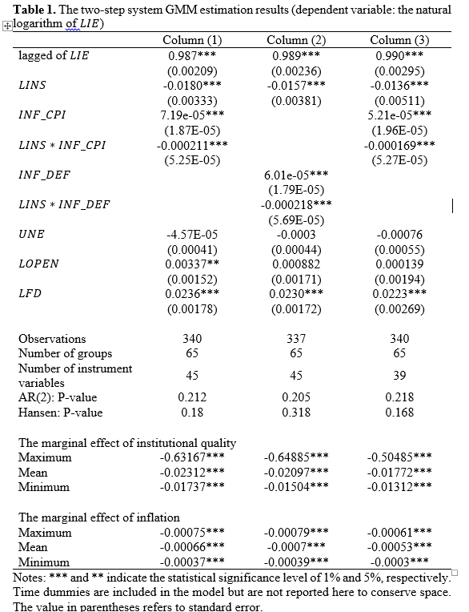

Slide 11
Conclusions and Suggestions
The coefficient signs alone suggest that inflation acts like regressive tax and good institutional contributes to lower income inequality
In terms of marginal effects, both variables reduces the income inequality.
Policy implications:
1) Develop institutional framework (lower inflation, improve quality of bureaucracy etc.) in designing policy to overcome income inequality.
2) While inflation seems to reduce income inequality, the impact is larger when institutional quality is at the maximum.
3) Nonetheless, the aggregate impact of inflation is rather small. Lower pressure on central banks to act to alleviate income inequality using a monetary policy???

Slide 12
Conclusions and Suggestions
Future researches could looks at:
Developed countries vs developing countries
Cross check the conclusions with interest rate
Non-linearity
Micro-level study (Household data).

Slide 13
Reference
Amendola, A., Easaw, J., & Savoia, A. (2013). Inequality in developing economies: The role of institutional development. Public Choice, 155, 43-60.
Azman-Saini, W. N. W., Ahmad Zubaidi, B. Law, S. H. (2010). Foreign direct investment, economic freedom and economic growth: International evidence, Economic Modelling, 27, 1079–1089.
Balcilar, M., Chang, S., Gupta, R., & Miller, S. M. (2018) The relationship between the inflation rate and inequality across U.S. states: A semiparametric approach. Quality & Quantity, 52, 2413-2425. doi: 10.1007/s11135-017-0676-3
Brambor, T., Clark, W. R., & Golder, M. (2006). Understanding interaction models: Improving empirical analyses. Political Analysis, 14, 63-82. doi: 10.1093/pan /mpi014
Colciago, A., Samarina, A., & de Haan, J. (2019). Central bank policies and income and wealth Inequality. Journal of Economic Survey, 1-33. doi: 10.1111/joes.12314
Monnin, P. (2014). Inflation and income inequality in developed economies (CEP Working Paper 2014/1). Retrieved from https://www.cepweb.org/wp-content/uploads/2014/05/CEP_WP_Inflation_and_Income_Inequality.pdf
Narob, N. (2015). Income inequality and inflation in developing countries: An empirical investigation. Economics Bulletin, 35(4), 2888-2902.
Saimi-Namini, S., & Hudson, D. (2019). Inflation and income inequality in developed and developing countries. Journal of Economic Studies, 46(3), 611-632.

Slide 14
Thanks for your attention

