Slide 1
Regression analysis and missing data- the problem with p-values
Dr Manimalar Selvi Naicker
MBBS, M.Path, M.MedStats
Medical Lecturer, Consultant Histopathologist & Statistician
Department of Pathology
Faculty of Medicine
University of Malaya

Slide 4
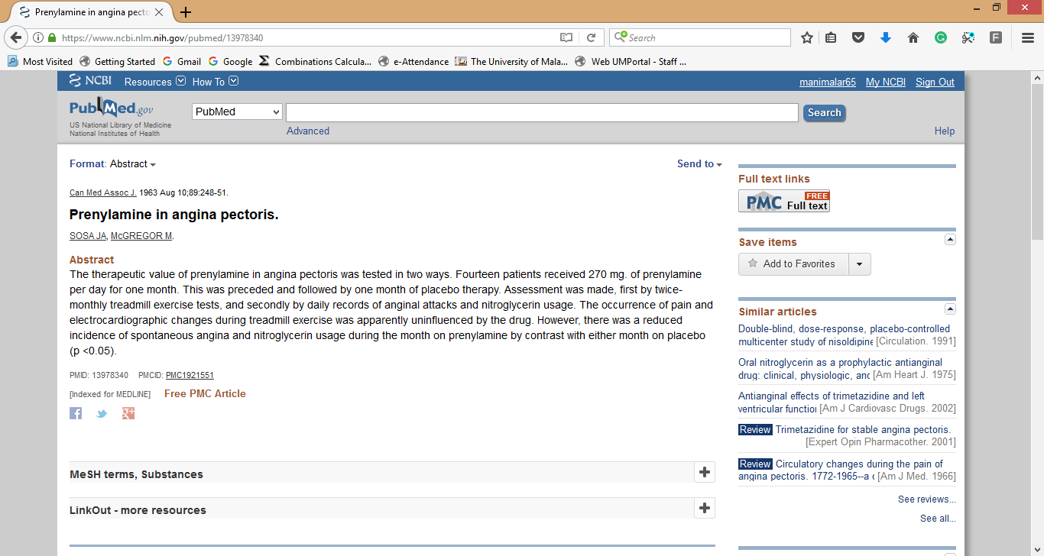

Slide 5
Sir Austin Bradford Hill
(Navy Pilot turned statistician)

Slide 8
Just in- A confession
Five ways to fix statistics
https://www.nature.com/articles/d41586-017-07522-z
Prof Dr Steven Goodman (Stanford) : Pediatrician-Statistician
He feels pressured to teach the wrong statistical methods because:
Too time-consuming to teach the right methods
Editors and peer-reviewers expect the wrong methods
Right methods do not enhance professional prospects of researchers

Slide 9
P-Value
Random Sample via Random Selection from Pop.
Asymptotic tails
Sample Size
Effect Size
Missing data (Sample Size & Effect Size)
Statistical (numerical) Confounding

Slide 10
P-Value on 0.05
BIOLOGICAL
BIOLOGICAL
This can change if data is MISSING in a MNAR way or due to CONFOUNDING
NON-BIOLOGICAL
If SAMPLE SIZE can be held constant then we know that the change in P-value is due to change in EFFECT SIZE only (eg confounding)
NON-BIOLOGICAL

Slide 11
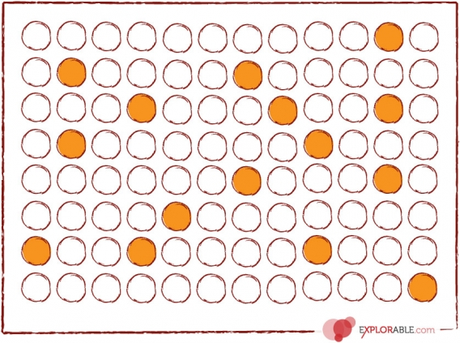
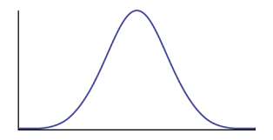

Random Sample: Survey
Sample Statistic
Descriptive and Inferential Statistic ((Mean, SD) (95%CI)
(Generalisable)
POPULATION OF CLINICAL MASTERS STUDENTS
N=1000
Sample of Clinical Masters Students
N=100

Slide 12
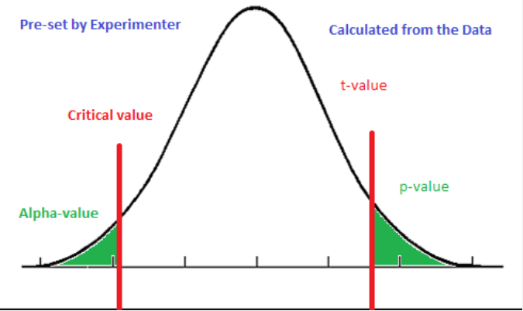
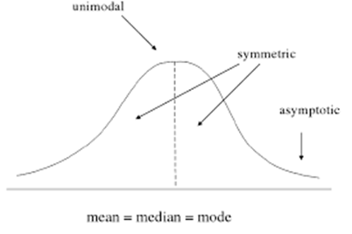
t-value | df=15 | df=30 | df=100
1 | 0.333170136 | 0.325308615 | 0.319724156
2 | 0.063945007 | 0.054625045 | 0.048212179
3 | 0.008972737 | 0.005389964 | 0.003407915
4 | 0.001159317 | 0.000381846 | 0.000121524
5 | 0.00015837 | 0.00000232967 | 0.00000245017
6 | 0.0000243265 | 0.00000139428 | 0.0000000317249

Slide 14
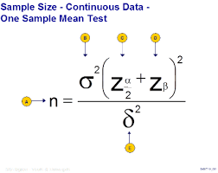

Slide 15
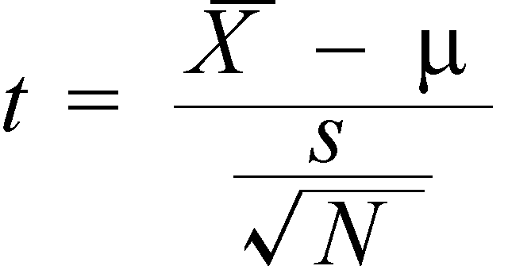
What is the T-statistic

Slide 16


SaMPLE SIZE CALCULATION
T-VALUE CALCULATION
EFFECT SIZE:$δ$
VARIATION:$σ$
T/C VALUE: Z($α,β)$
SAMPLE SIZE: n
EFFECT SIZE: X-$μ$
VARIATION: s
T/C VALUE: t
SAMPLE SIZE: n

Slide 18
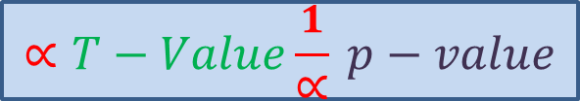
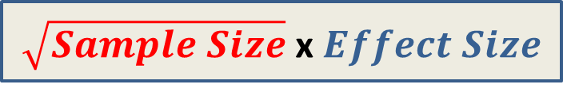
If sample size is constant any change in effect size is due to confounding (1 change only)
If sample size is not constant then 3 issues need to be address
T-value (and hence p-value) will change due to:
Change in sample size
Bias to Effect Size: due to loss of data in a non-random way
Change to Effect Size: Statistical confounding effect (what we really want to know)
$\sqrt{Sample Size}$ x $Effect Size$
$$∝T−Value\frac{1}{∝} p−value$$

Slide 19
P-Value is a composite index of
BIOLOGICAL EFFECT SIZE
NON-BIOLOGICAL SAMPLE SIZE
Both can move p-value around
If sample size is held constant (ie no missing data) we can attribute the change in p-value to EFFECT SIZE changes.
If both EFFECT size and SAMPLE SIZE change simultaneously as in missing data and adjusting for confounders, how will we untangle the respective proportion attributable to each?

Slide 20
Statistics is based on
Random sampling if using inferential to generalize
Complete data
If data is missing software assumes MCAR/MAR – but is this assumption correct?
Eg Kaplan Meier
http://www.bu.edu/sph/files/2014/05/Marina-tech-report.pdf

Slide 21

Data Used
http://calcnet.mth.cmich.edu/org/spss/Prjs_DataSets.htm
BODY FAT DATA

Slide 23
reg y x1
N=20
B= 0.887
Standardized B=0.924
R2= 0.853
T-Value=10.240
P-Value=0.000

Slide 24
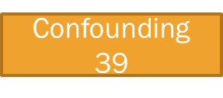
reg y x1
N=20
B= 0.887
Standardized B=0.924
R2= 0.853
T-Value=10.240
P-Value=0.000
reg y x1 x2
N=13
B=0.848
Standardized B=0.897
R2=0.998
T-Value=65.926
P-Value=0.000

Slide 25
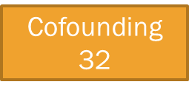
reg y x1
N=20
B= 0.887
Standardized B=0.924
R2= 0.853
T-Value=10.240
P-Value=0.000
reg y x1 x2
N=20
B=0.855
Standardized B=0.891
R2=0.999
T-Value=97.5
P-Value=0.000
reg y x1 x2
N=13
B=0.848
Standardized B=0.897
R2=0.998
T-Value=65.926
P-Value=0.000

Slide 26
reg y x1
N=20
B= 0.887
Standardized B=0.924
R2= 0.853
T-Value=10.240
P-Value=0.000
Cofounding
32
reg y x1 x2
N=20
B=0.855
Standardized B=0.891
R2=0.999
T-Value=97.5
P-Value=0.000
Confounding
39
N changed
B changed
reg y x1
N=13
B=0.852
Standardized B=0.901
R2=0.812
T-Value=6.888
P-Value=0.000
reg y x1 x2
N=13
B=0.848
Standardized B=0.897
R2=0.998
T-Value=65.926
P-Value=0.000
Confounding 4

Slide 31

Thank YOU FOR PATIENTLY LISTENING

