Slide 1
GRAPHICAL ABSTRACT GUIDELINE
Number of pages: 1 only
Must contain
  Name of PI
  CoE Niche area
  Project title
  Problem statement
  Proposed solution(s)
  Stakeholder(s) involved
  Potential impact(s) / outcome(s)

Slide 2
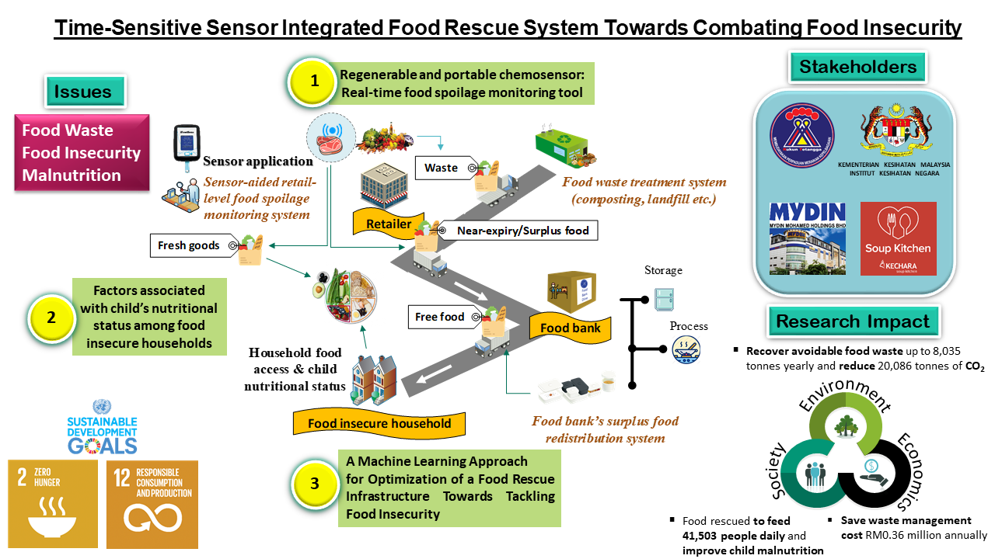
Name of PI
CoE Niche Area
Project
title
SAMPLE

Slide 3











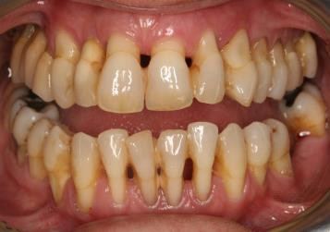
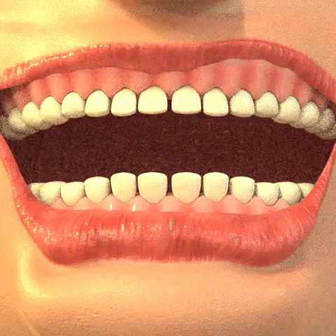

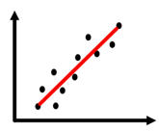

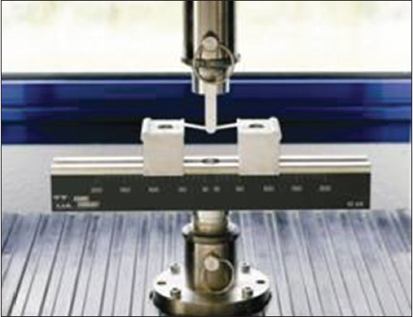

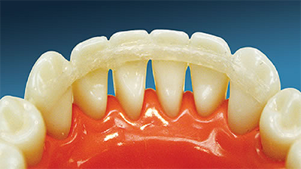

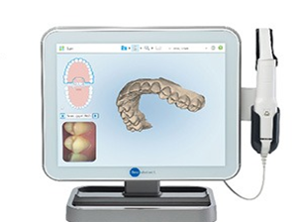
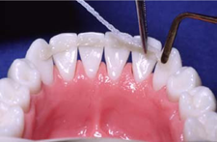
Name of PI
CoE Niche Area
Project
title
Tailor-made Fibre-reinforced Composite (FRC) Splint Fabrication for Management of Hypermobile Teeth in Periodontally Compromised Patients
SAMPLE
OHIP-14 & NutQoL
B40
ELDERLY
Fracture analysis
Hypermobile teeth
(Periodontally compromised patients)
Tailor-made FRC splint
Fibre-reinforced composite (FRC) splint fracture

